Slide 1
SCHOOL-BASED ITN DISTRIBUTION
ORIENTATION OF KEY STAKEHOLDERS
JULY/AUGUST 2023

Slide 2
Outline of Presentation
Introduction to School-Based ITN Distribution
Training Objectives and Outcomes
Overview of Malaria
Insecticide Treated Nets (ITNs)
Continuous Distribution of ITNs
Communication and Social Mobilization
Organizing and Managing the School ITN Distribution Activities
Monitoring and Record Keeping; Use of Net4Schs application
Roles and Responsibilities
Micro Planning and Logistics

Slide 3
Introduction
GHS/NMEP & development partners are working towards reducing malaria related morbidity and mortality by ensuring all children under five years, pregnant women and subsequently everybody own and sleep under an ITN every night and all-through the night
School-based ITN distribution is a major step towards the achievement of this objective
Ghana has already conducted 8 annual rounds of school-based distribution since 2012. 9.2million ITNs have been distributed.
The 2023 distribution will utilize the Net4Sch App to report on ITNs distributed and for monitoring. The Net4sch App has successfully been used since 2020.

Slide 4
Objectives of the Training
To equip participants with appropriate knowledge and skills to implement and supervise the primary school ITN distribution
To ensure effective planning and communication among district teams and school heads on the 2023 ITN distribution
Master the use of Net4Schs App to collect data during distribution
To ensure effective communication and promotion of behaviors and behavior change in relation to ITN acceptance, regular use and proper care

Slide 5
Expected Training Outcome
Understand malaria transmission and the role of ITNs in malaria prevention
Understand the Continuous Distribution Strategy
Discuss the organization and management of the Primary School ITNs distribution exercise
Describe strategies to promote and influence the correct use of ITNs among beneficiaries
Explain the roles and responsibilities of the key actors involved in the strategy

Slide 6
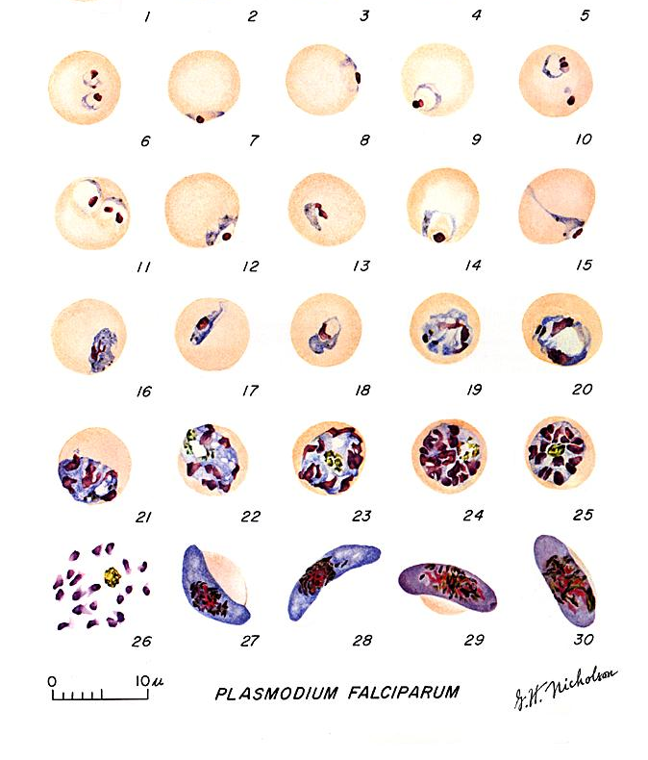
Malaria Overview
What is Malaria and what causes it?
Malaria is an infectious disease. It is caused by a parasite called Plasmodium, a small parasite which cannot be seen with our naked eyes but only with a microscope. It infects the red blood cells of the human body.
How is Malaria transmitted?
Malaria is transmitted when an infected Female Anopheles Mosquito bites a person and injects the malaria parasite (sporozoites) into the person’s blood.

Slide 7
Malaria – What are the Facts?
In Ghana, malaria kills more children than any other age group.
Malaria is the most common cause of convulsions and loss of consciousness among children, not bad spirits or witchcraft as some people believe.
Malaria is the leading cause of children’s absenteeism at school and affects children’s intellectual capabilities.
Some children who recover from cerebral malaria suffer disabling neurological damage, including mental disability and epilepsy.

Slide 8
Malaria – What are the facts Cont’d;
Families lose a lot of money on treatment of malaria and on transport to health facilities.
Families and workers also lose a lot of time meant for gainful work.
In pregnant women, malaria causes anaemia, miscarriages, stillbirths, underweight babies and maternal deaths.
Children under 5 years and pregnant women are most affected by malaria and therefore should be given priority to sleep under the nets.

Slide 9
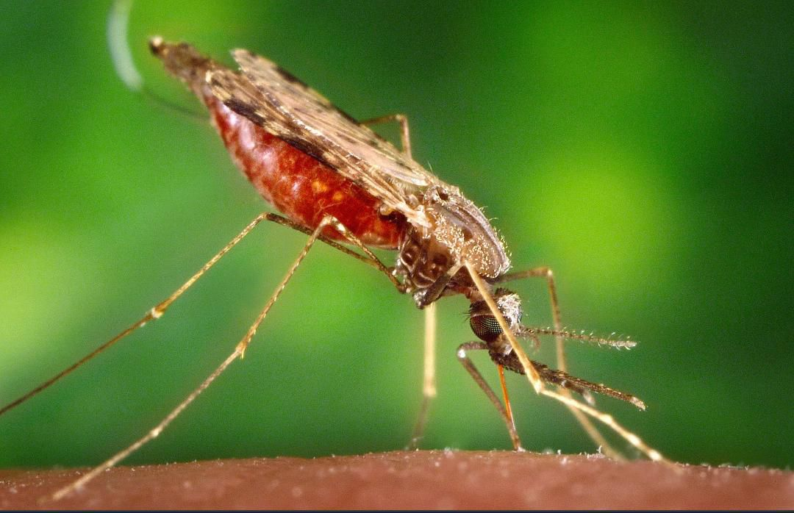
Malaria – What are the Facts Cont’d;
The environmental conditions in most parts of Ghana favour mosquito breeding all year round resulting in transmission of malaria throughout the year
The Malaria carrying female Anopheles Mosquito usually bite in the night and indoors and is the only one that can transmit Malaria
*New Anopheles discovered in Ghana

Slide 10
Anopheles stephensi - 1/2
In 2019, the WHO alerted on the invasion of Africa by An. stephensi
Competent malaria vector, highly efficient vector of P. falciparum and P. vivax
Unique because it is adapted to breed in non-traditional breeding sites of the usual An. species
Ponds
Swamps
Marshy areas
Artificial containers and other man-made containers spots
Can practically breed in almost all sources of water
Can survive extremely high temperatures during the dry season, when transmission usually declines

Slide 11
Anopheles stephensi - 2/2
An. stephensi has shown resistance to multiple insecticide classes in many locations, including Africa
Until 2011, An. stephensi was confined parts of Southern Asia and the Arabian Peninsula
Since then, the vector has been collected in Djibouti (2012), Ethiopia & Sudan (2016), Sri Lanka (2017), Somalia (2019), Nigeria (2020) and Yemen (2021), Kenya (20203)
In March 2023, Ghana confirmed An. stephensi, in Tuba and Dansoman, all urban areas of GAR
Notes:
Anopheles will not breed in fast flowing water canals as well as heavily polluted water especially contaminated with faecal matter

Slide 12
What Ghanaians MUST DO
Removal of breeding sites in and around homes, including filling/covering disused wells
Modify breeding sites to prevent mosquito access e.g. cover water containers
Sleep under insecticide treated nets to protect against indoor mosquito bites
Use repellants and wear protective clothing to protect against outdoor mosquito bites

Slide 13
What Ghanaians MUST DO
Ensure windows and door screens are intact
Use/adhere to other existing interventions (ITNs)
Report to health facility promptly with fever
Get tested before treating malaria
Take medications according to prescription
Take SP to protect mother and baby when pregnant

Slide 14
Insecticide Treated Nets (ITNs)
ITNs are mosquito nets impregnated with insecticide
They are factory treated type of ITN which does not need to be re-treated
The insecticides lasts for about 3 years
ITNs should be washed for a maximum of 20 times in 3 years
The insecticides used for ITNs are approved to be safe by the World Health Organization (WHO) and the Ministry of Health.
Notes:
1. Reduce

Slide 15
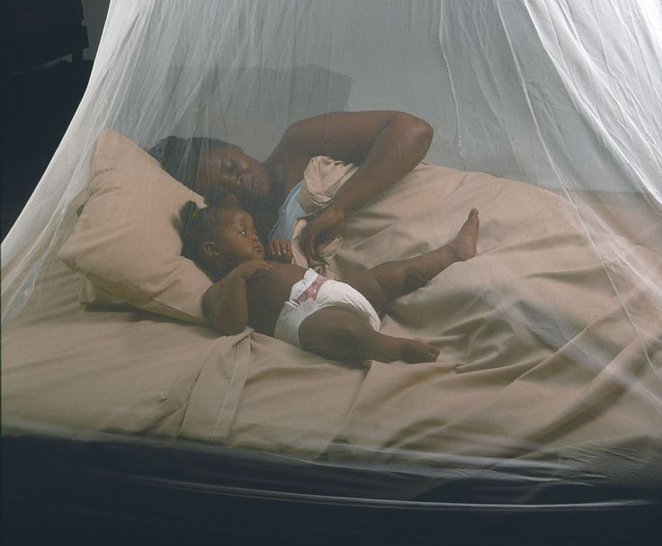
How do ITNs prevent Malaria?
ITNs provide both a physical and chemical barrier between humans and the Anopheles mosquito, thereby preventing the malaria parasite from being transmitted through the mosquito bite.
Any mosquitoes that come into contact with the ITNs either repelled, disabled and or killed by the insecticide used in treating the net.
Notes:
1. Reduce

Slide 16
Continuous Distribution of ITNs
Previous Malaria prevention strategies focused on high ownership and use of ITNs by the vulnerable groups
More recently the goal has shifted to “Universal Coverage” where every person in malarious regions sleeps under an ITN
In addition to providing personal protection to the population covered, it is expected that ITNs will lead to a decline in malaria transmission.

Slide 17
Objectives of Continuous Distribution
Increase access to ITNs on a continuous basis between mass campaigns
Provide ITN for replacement and “add-on” to sustain “universal coverage”
Avoid oversupply (spill-over) by combining “push” and “pull” strategies
Use the household as entry point for ITN with intra-family or intra-community redistribution based on need
Utilize all suitable channels with combinations of free, subsidized and at cost nets where possible

Slide 18
Ghana’s ITN Continuous Distribution (CD) Strategy
Ghana has conducted four (4) mass distribution of ITNs since 2010/11 towards achieving universal coverage.
To maintain universal coverage, Ghana aims at targeting a variety of population groups.
To use different channels to ‘push’ nets into households periodically throughout the growth of the household from couple to family and beyond

Slide 19
ITN Distribution (Going Forward)
ITN DISTRIBUTION STRATEGIES
Health Facility ( all year round every year)
School Based ( Every year except mass campaign year)
Mass Campaign strategy every 3 years
HIV/AIDS Clinics
Existing patients (all patients on ART)
Every new patient
New nets every three years
Continuous Distribution (CD) Strategy
TB Clinics
Everyone currently on treatment (started treatment from November/December 2022
First TB patients

Slide 20
Key Channels
Health Facility
Primary School Distribution
Pupils in P2 and P6
Ante Natal Clinic (ANC)
Pregnant women at 1st ANC Visit
Child Welfare Clinic (CWC)
Children 18 months due for measles/rubella 2 vaccine (Booster dose)

Slide 21
COMMUNICATION AND SOCIAL MOBILIZATION

Slide 22
Communication and Social Mobilization
School net use and care Social Behavior Change Communication (SBCC) is an important component of the ITN distribution campaign
School Health Teams (SHTs) have been trained in over 23,894 schools on malaria prevention, ITN use and care
Activities and specific messages have been designed targeting 4 main audiences (Pupils, Teachers, Parents & Community leaders)
SBCC recommended materials have been identified
Ensure continuous implementation of the SBCC program in schools

Slide 23
Frequently Asked Questions (FAQs) about ITNs
How do ITNs work?
Why do I see mosquitoes around my net?
How do I hang my ITN?
When should a ITN be used?
Are young children safe under an ITN?
Are pregnant woman and unborn babies safe under an ITN?
What about the side effects people get from newly- opened ITNs?
How should I care for my ITNs?

Slide 24
Key Points to Note
All school children/pupils should be included in SBCC activities to ensure all children/pupils understand malaria prevention and ITN use and care.
All key stakeholders such as circuit supervisors, head teachers/teachers, parents and community leaders should support the promotion of ITNs use and care in the communities
Integrate malaria education in PTA/SMC meetings and other community programs especially the benefits and proper use and care of ITNs

Slide 25
Organizing And Managing The School-based Itn Distribution Activities

Slide 26
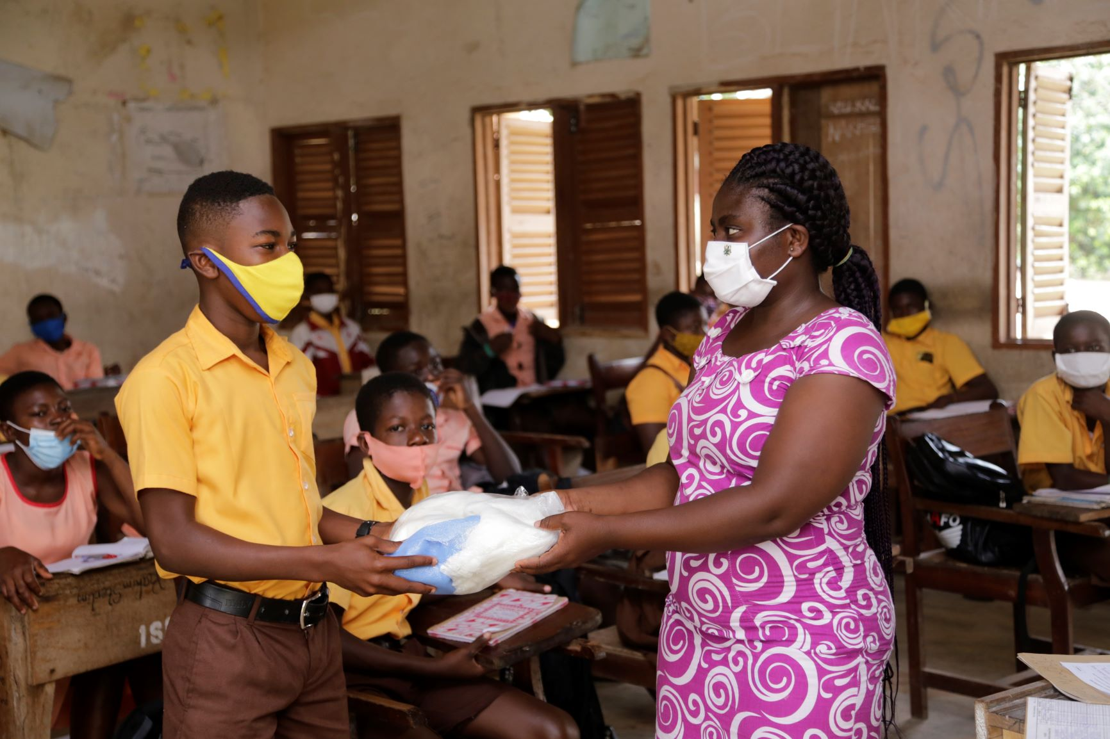
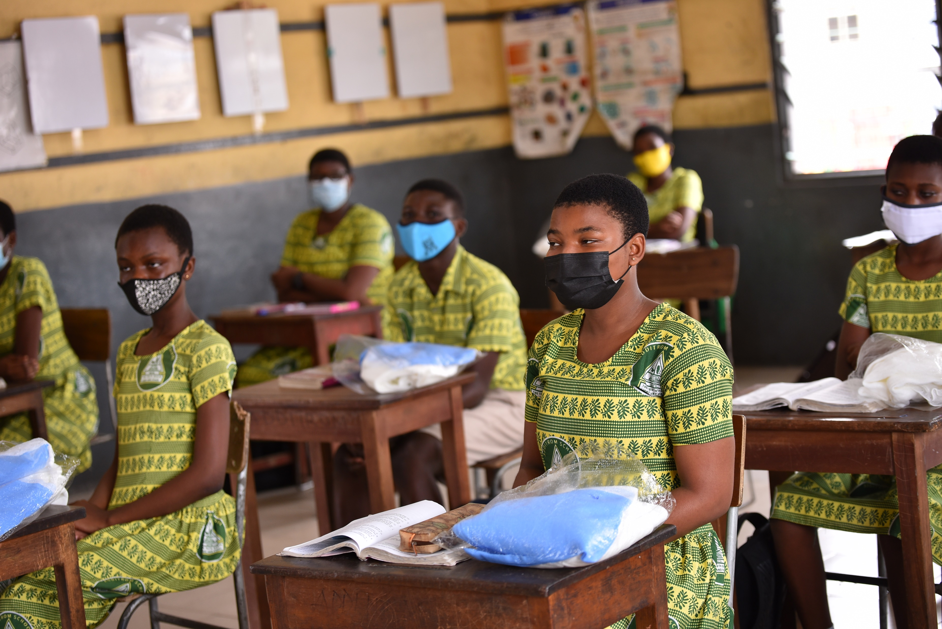
Organizing and Managing the School-Based ITN Distribution Activities

Slide 27
School ITN Distribution Activity Flow
Virtual ToT for RSHEPS
and RMFPs
Virtual training of DDEs, AD/DD SUPs, SHEP Coord, Private School Coordinators, MFP, DD-GHS
In-person training
SISOs
Transportation of ITNs from National to District Education Stores and Schools
Distribution of ITNs and SBCC
Third Party Logistics Officers
(3PLs)
Orientation of Key stakeholders
Public and Private Basic Schools
P2 and P6 by class teachers

Slide 28
When and How will the Distribution Take Place?
August 14-25, 2023
All Public and Private primary schools captured in EMIS database are involved
3PLs will transport ITNs to all schools from the District Education Stores.
Distribution to P2 and P6 Pupils based on the number of pupils on roll and not necessarily ITNs delivered by 3PLs.
SISOs will monitor the excercise and re-distribute ITNs based on need.
All excess nets will be returned to the district stores.

Slide 29
COVID-19 Adaptions for Distributing ITNs to Pupils
All officers involved in monitoring should always maintain at least 2 meters social distancing.
Thoroughly clean hands with an alcohol-based sanitizer or wash them with soap and water before physically handling ITNs.
Only class teacher or head teacher should be involved in distributing nets to school pupils.
No officer on monitoring should be involved in distributing ITNs to school pupils.
Head teachers should ensure social distancing for P6 pupils or parents who report to school for their nets.

Slide 30
Monitoring and Reporting
Form A and Net4SCHS App

Slide 31
School Distribution Form A
Filled by Class Teacher
Should be Filled during the distribution period in accordance with class enrollment/register
Class Teacher, Head Teacher and Circuit supervisors should sign after distribution
The signed form should be kept at the school
Form B, C, D & E have all been converted into the Net4Schs App

Slide 33
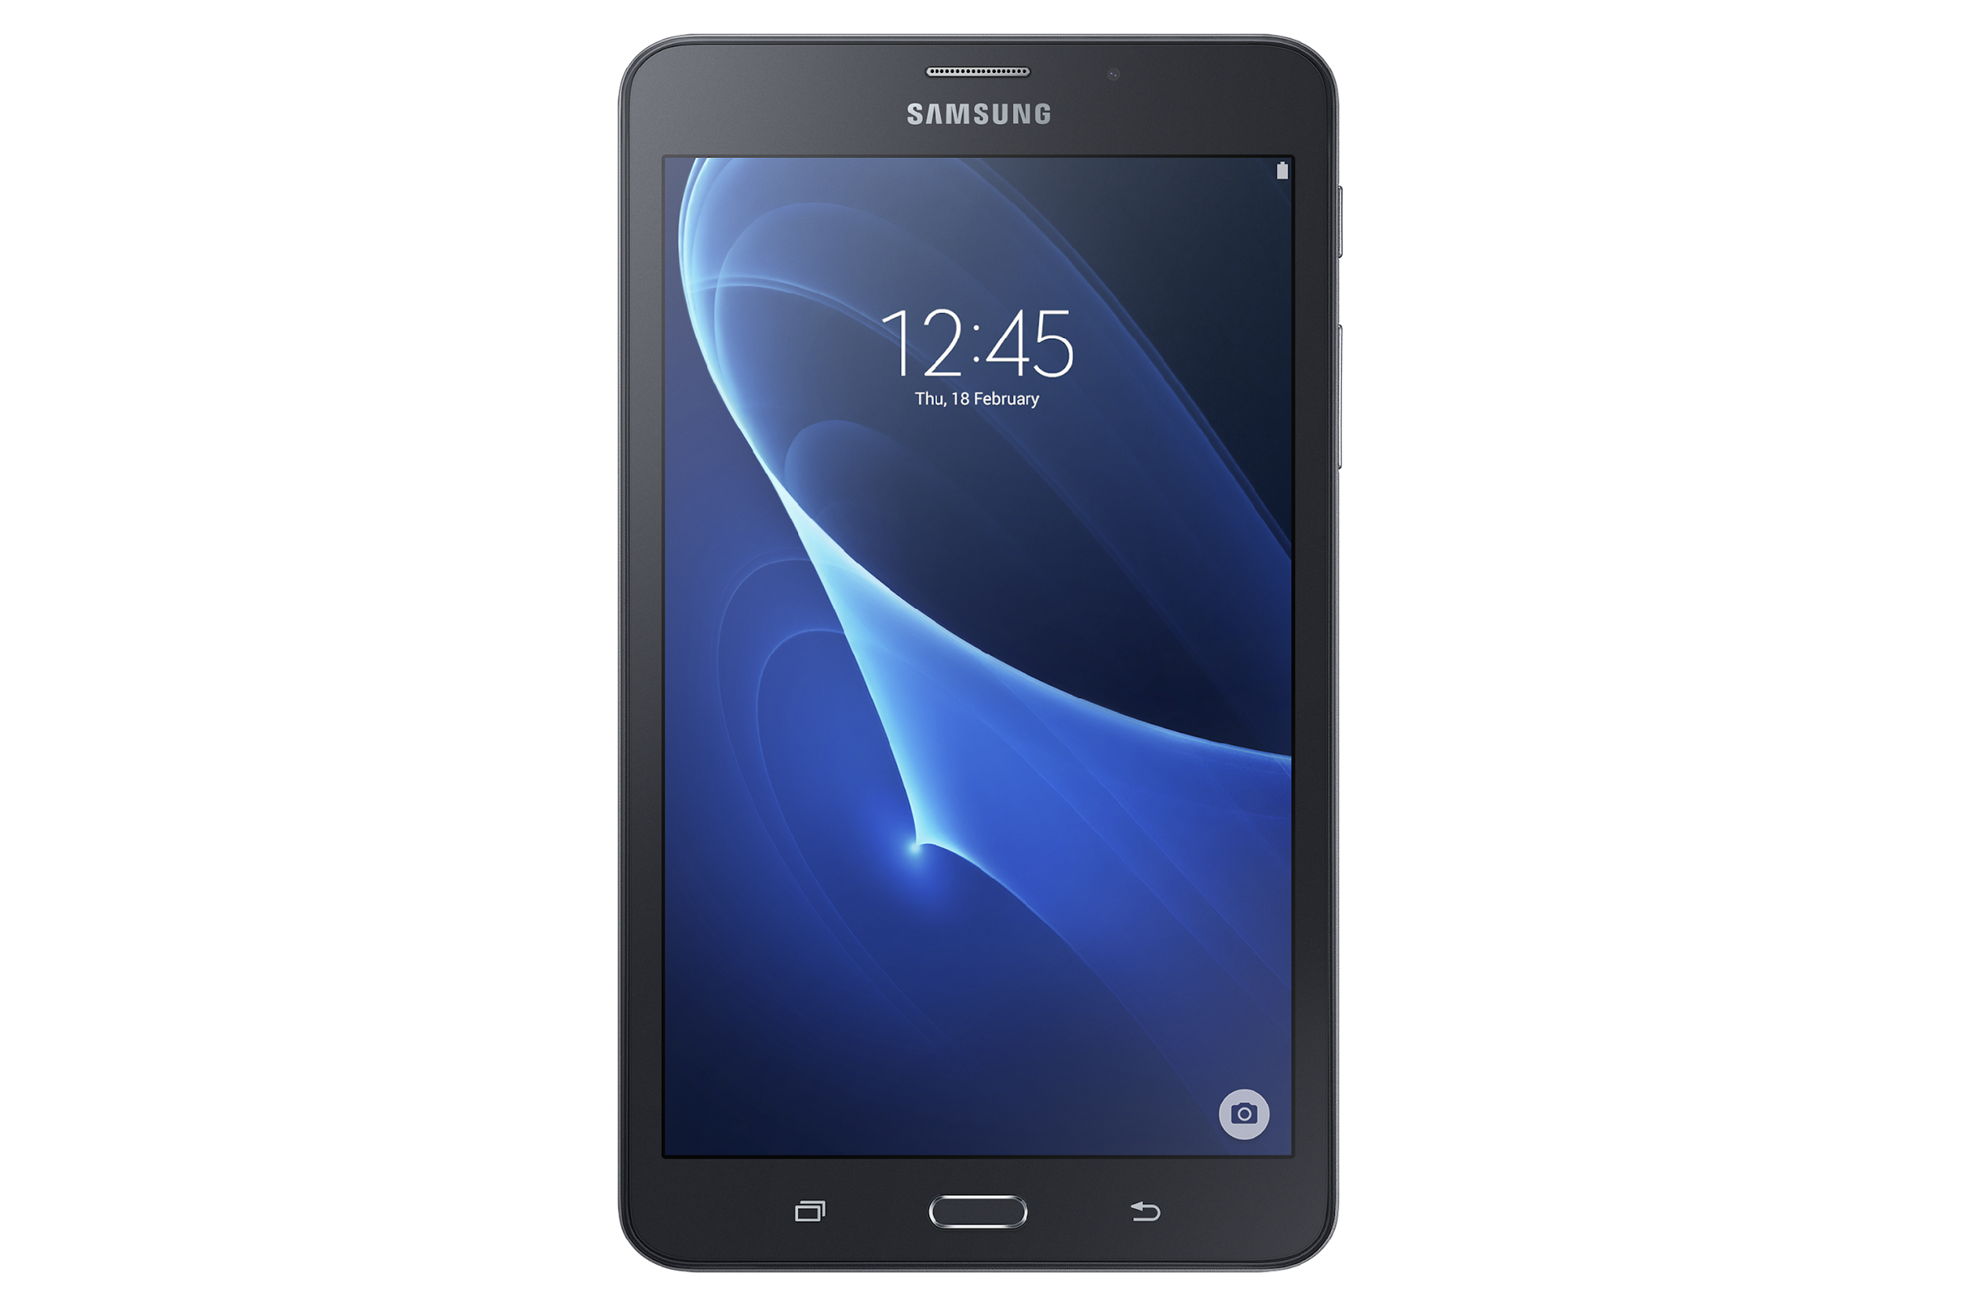
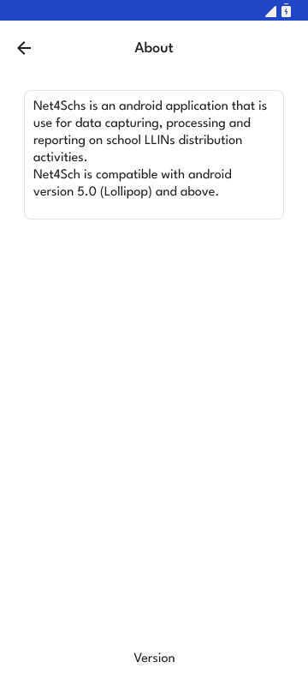
ABOUT APP

Slide 34
SPLASH SCREEN
Splash screen appears after launch of Net4Schs app

Slide 35
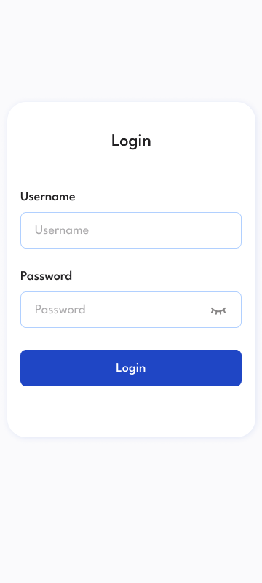
LOG IN
Credentials – Input correct Username and Password assigned to a user
Tap on LOG IN with good internet access
Image with figures

Slide 36
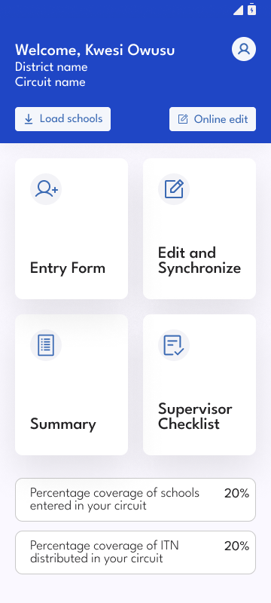
DASHBOARD 1/2
Welcome name and details of work area is displayed on top of the dashboard
Percentage coverage of schools entered in your circuit displays the coverage of schools which have completed their entry form in the circuit
Percentage coverage of ITNs distributed displays the coverage of nets that have been distributed in the circuit
Notes:
36

Slide 37
DASHBOARD 2/2
Tap on Entry Form to input Form A summary
received from the School
Tap on Edit and synchronize to edit and submit offline data
Tap on Summary to view ITNs distribution details for schools in the circuit
Tap on Supervisor’s Checklist to access blank form, edit & synchronize form and view summary details
Notes:
37

Slide 38
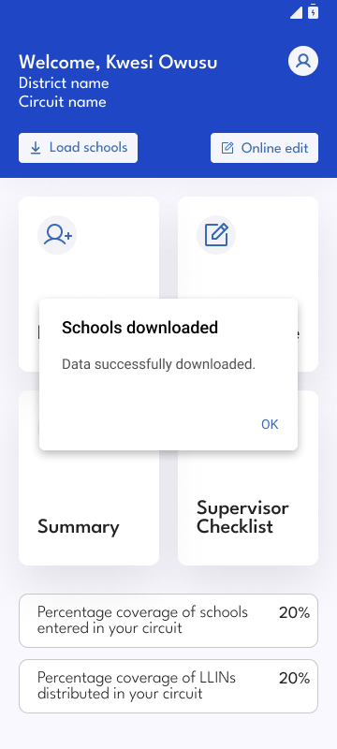
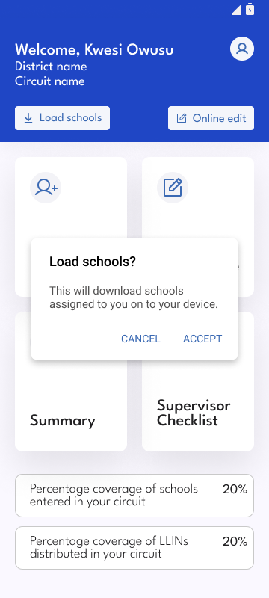
LOAD SCHOOLS
Tap on Load schools with internet access to load schools in the circuit onto the mobile device
Tap Accept to proceed

Slide 39
COMPLETING FORM A
Select school
Input ITNs supplied by 3rd party logistics
Were additional ITNs supplied by CS?
Input number on roll from P2 and P6 register
Input ITNs distributed to P2 and P6 from Form A
Notes:
39

Slide 40
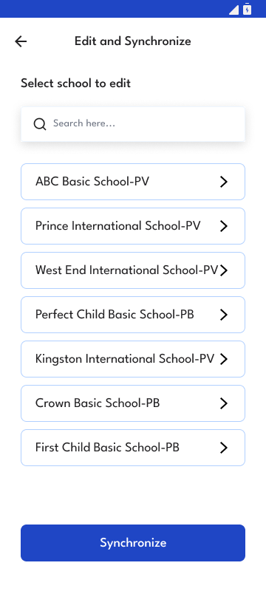
EDIT AND SYNCHRONIZE DATA 1/2
Tap on Edit and Synchronize button to correct mistakes made on entry forms if any

Slide 41
EDIT AND SYNCHRONIZE DATA 2/2
Tap on SYNCHRONIZE with good internet access to submit completed forms to district/region/national

Slide 42
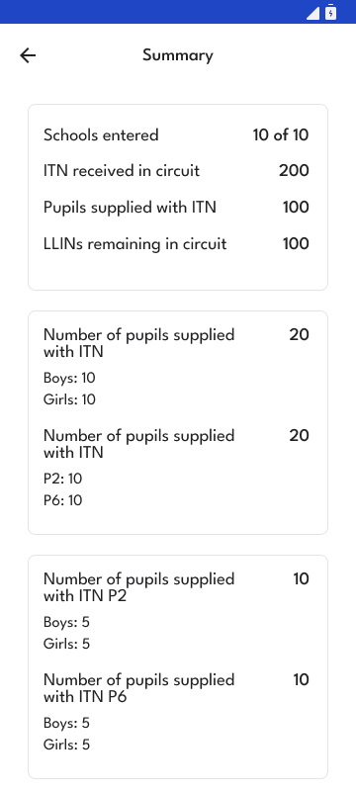
SUMMARY DATA
This page displays summary details of number of schools and nets distributed in the circuit

Slide 43
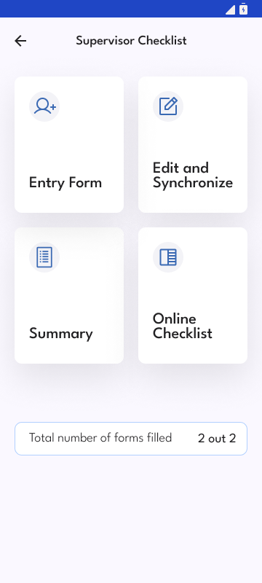
SUPERVISOR’S CHECKLIST 1/6
Tap on Supervisor’s checklist to;
Enter Form - Fill blank form
Edit and Synchronize offline forms
Check summary of work done in the circuit
Check synchronized forms
Total number of forms filled

Slide 44
SUPERVISOR’S CHECKLIST 2/6
Tap on Entry Form to fill a supervisory form
Read all cautions under questions when completing the form

Slide 45
SUPERVISOR’S CHECKLIST 3/6
Select school
Did the school receive the required number of ITNs? Yes or No
Did all eligible pupils receive their ITNs? Yes or No
If No, Select reason
Are school pupils educated on ITNs use and care? Yes or No
Does the school have materials for malaria education?
Does the school have health program for the term? Yes or No
Number of malaria activities on programme
Number of malaria prevention activities implemented this term.

Slide 46
SUPERVISOR’S CHECKLIST 4/6
Edit or Synchronize data
Tap on edit and synchronize to view or edit form
Tap on SYNCHRONIZE with good internet access to submit information to district/region/national

Slide 47
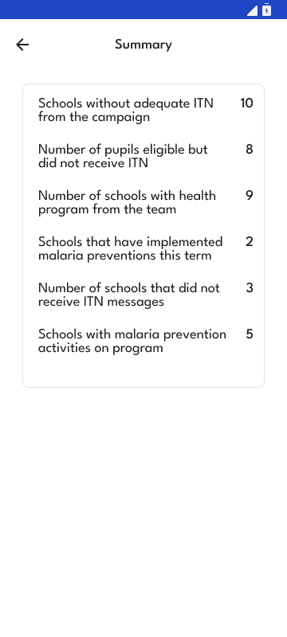
SUPERVISOR’S CHECKLIST 5/6
Summary
Tap on summary to view summary details of the submitted forms

Slide 48
SUPERVISOR’S CHECKLIST 6/6
Online Checklist
Tap on Online Checklist to check or edit online data

Slide 49
SETTING UP HOTSPOT
On your personal phone
Go to settings
Go to connections
Turn on data
Turn on hotspot
Set hotspot password
Leave hotspot turned on

Slide 50
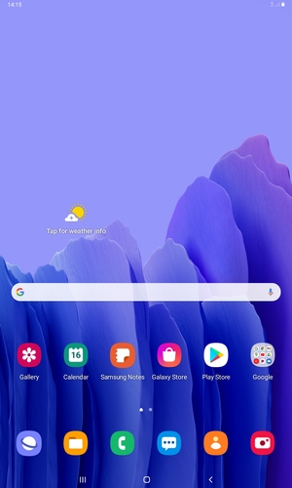
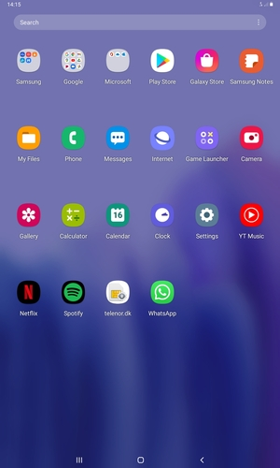
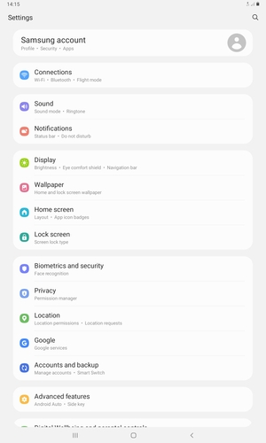
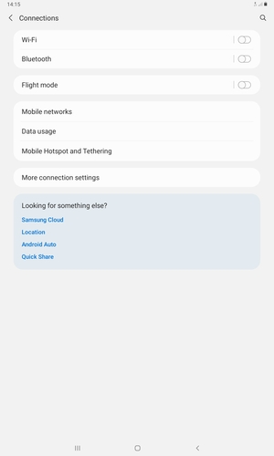
CONNECTING INTERNET TO TABLET 1/2
Swipe up
Select settings
Select connections
Select wifi

Slide 51
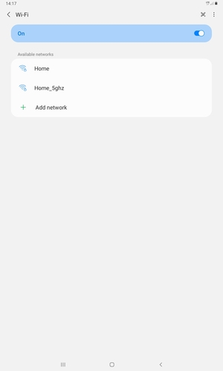
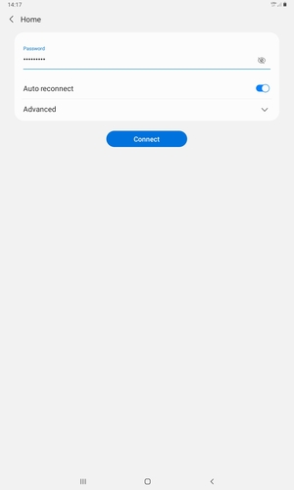
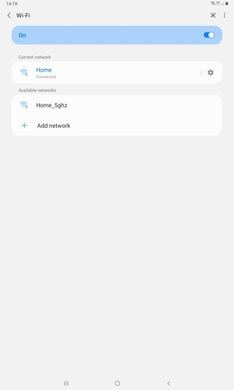
CONNECTING INTERNET TO TABLET 2/2
Turn on wifi
Select wireless network
Enter Password and select connect
Tab is connected

Slide 52
Net4Schs WEB APP
url - https://www.net4schs.org

Slide 53
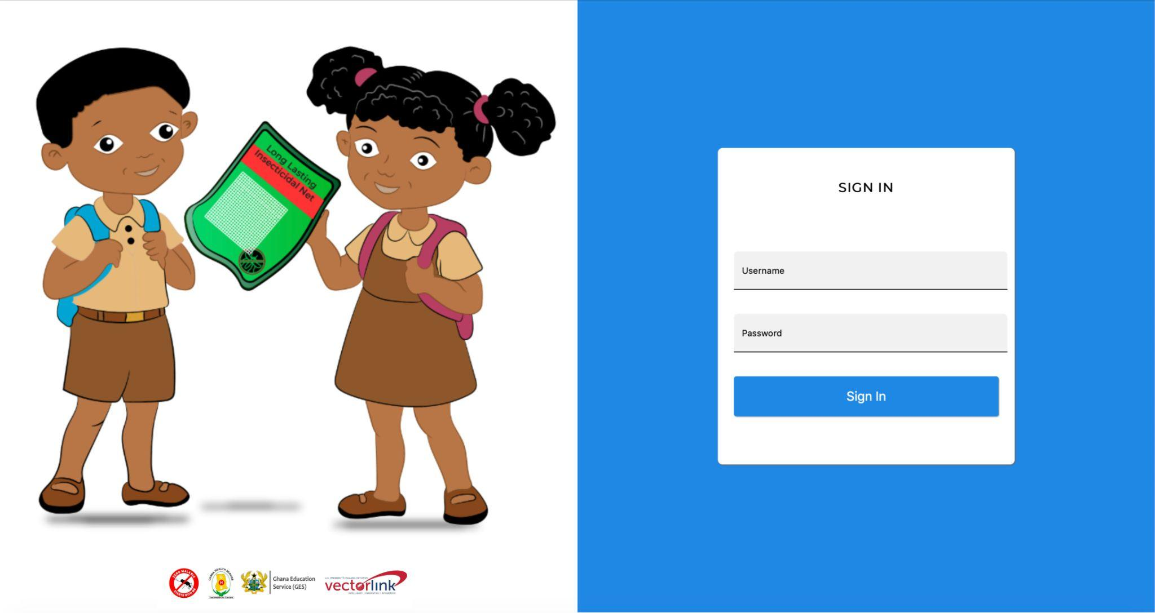
Net4Schs WEB SIGN IN

Slide 54
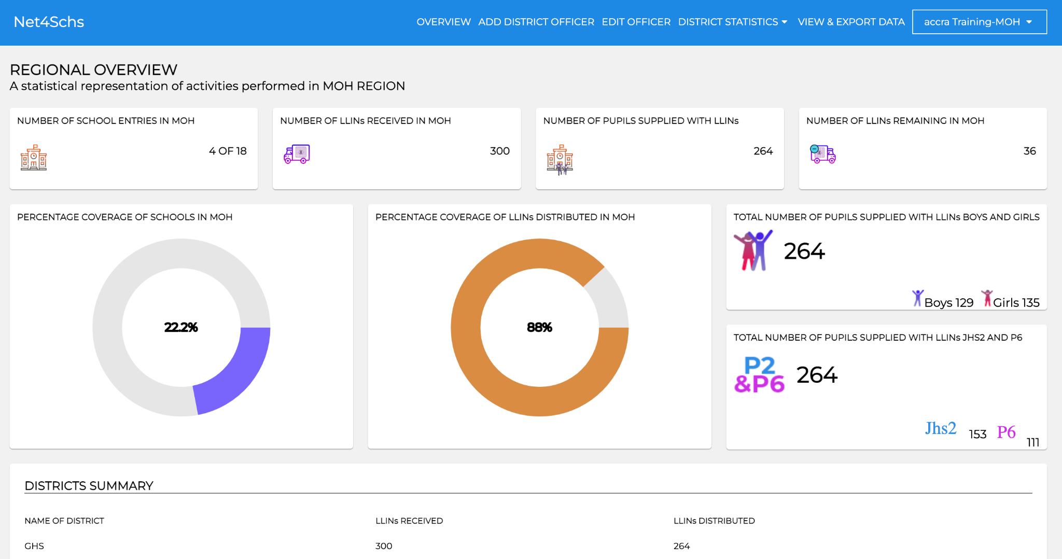
Net4Schs WEB DASHBOARD

Slide 55
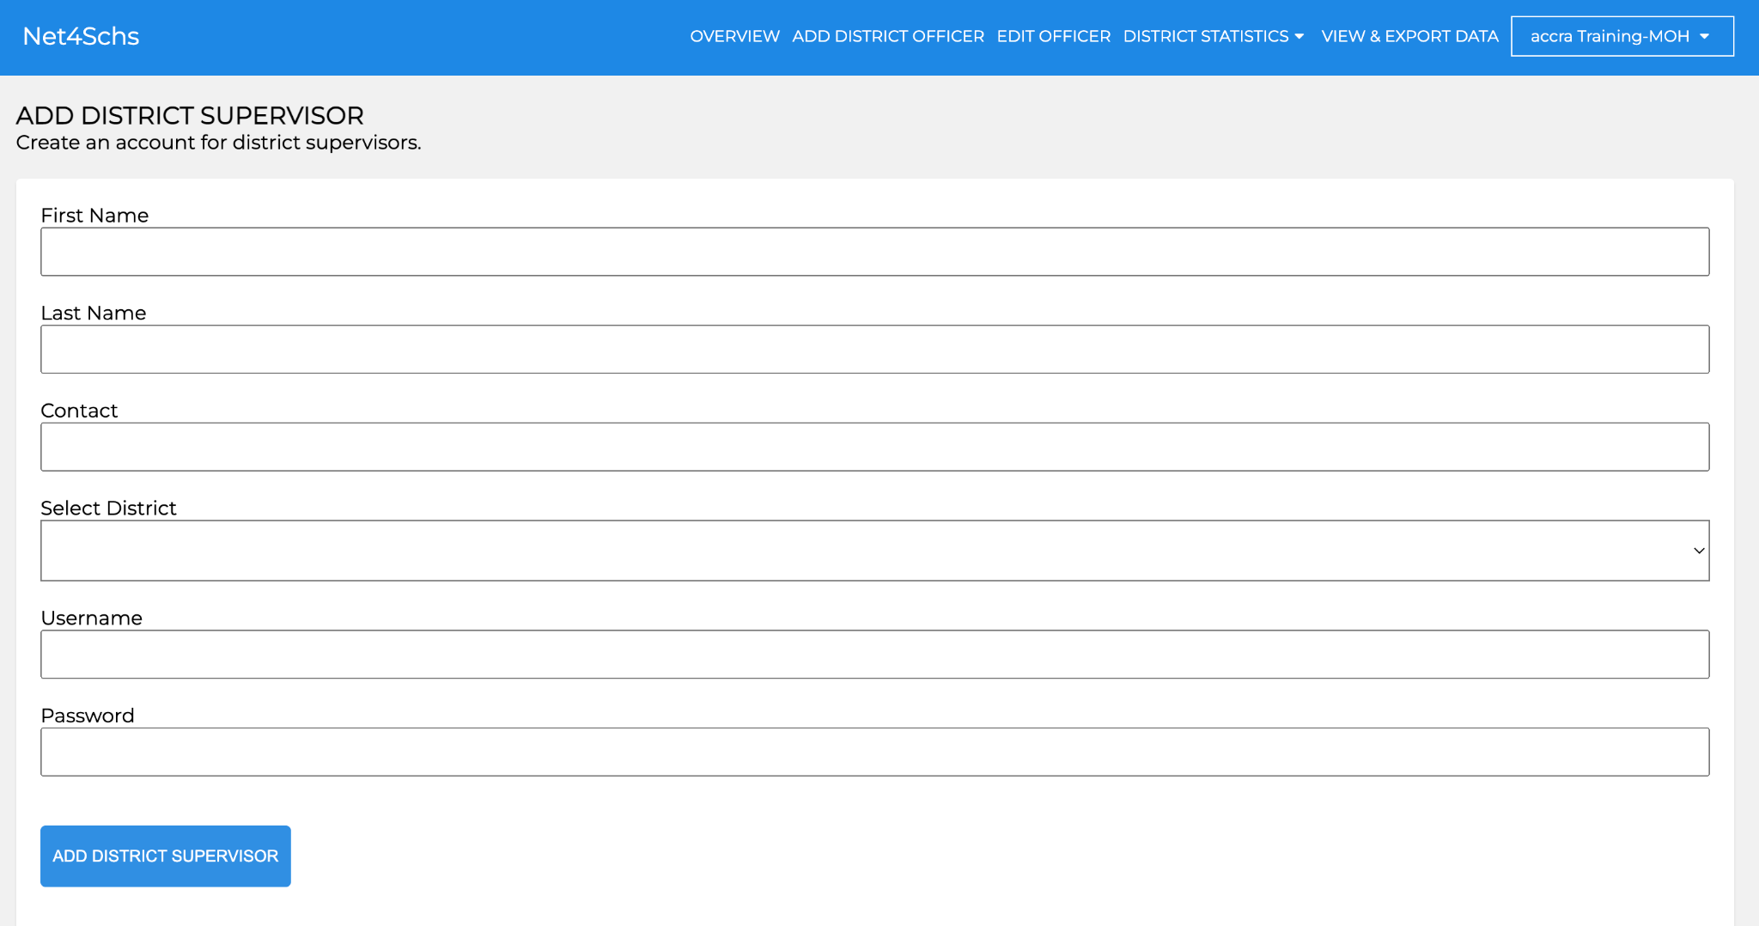
Net4Schs WEB DASHBOARD - ADD OFFICER

Slide 56
Net4Schs WEB DASHBOARD - EDIT OFFICER

Slide 57
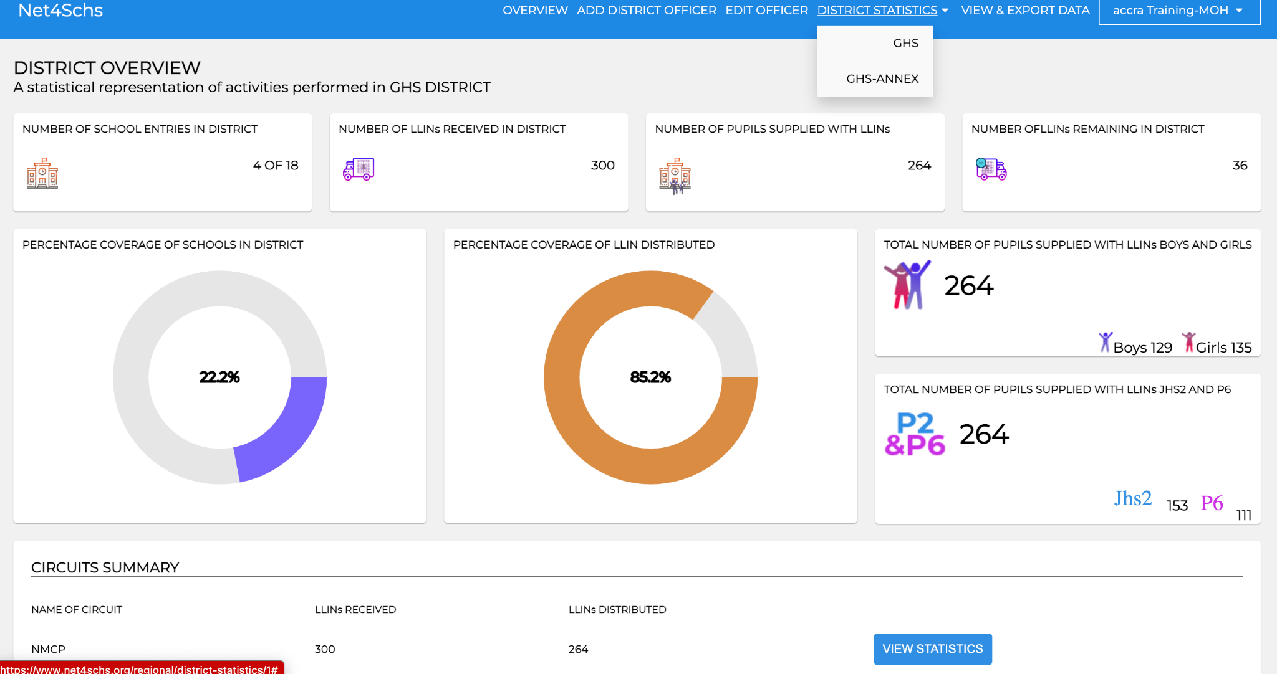
Net4Schs WEB DASHBOARD - STATISTICS

Slide 58
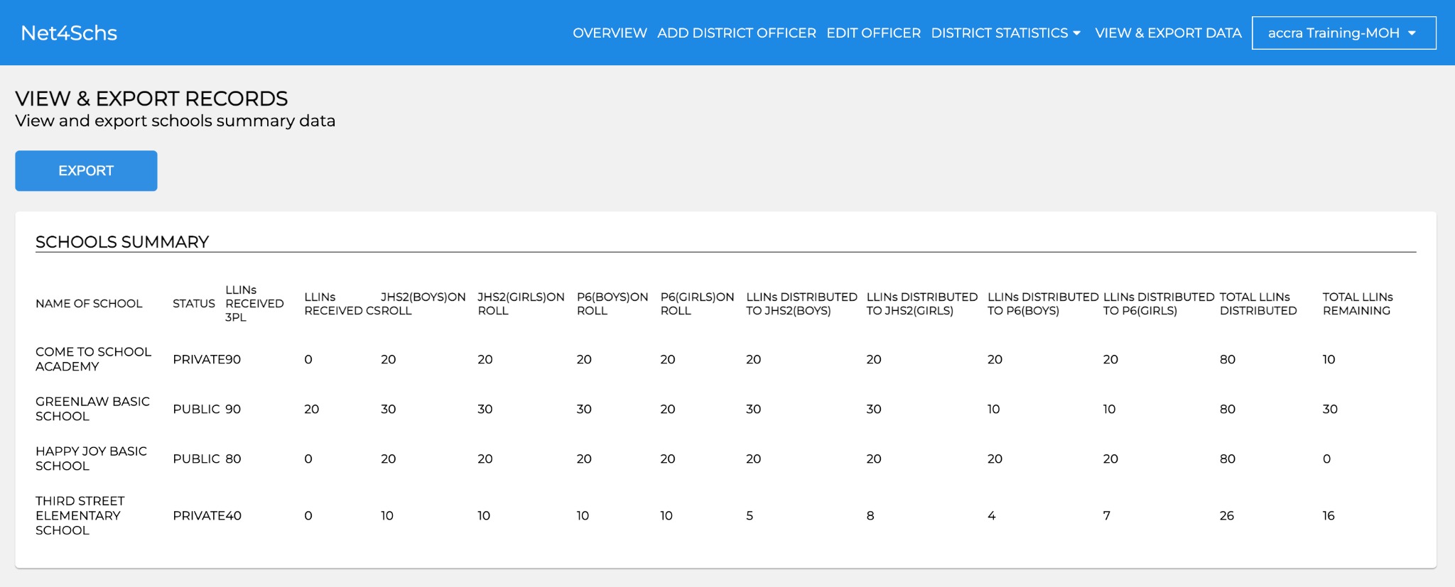
VIEW AND EXPORT DATA

Slide 59
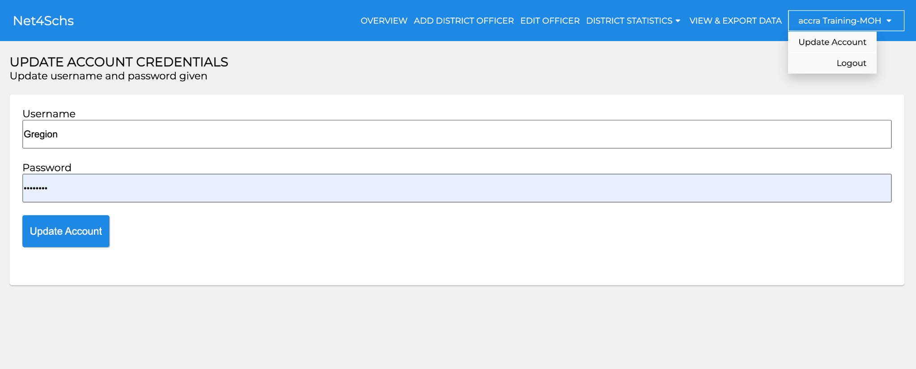
UPDATE ACCOUNT OR LOGOUT

Slide 60
ROLES AND RESPONSIBILITIES

Slide 61
Head Teacher/ Class Teacher/ School Based SHEP Coord
Registration of beneficiaries and completion of Form A
Form A Should be kept by Head Teachers in all Schools
Distribution of nets to school children with guidelines.
Education of pupils on malaria transmission and the prevention of malaria, care and use of ITNs

Slide 62
Circuit Supervisors
Supervise allocations and distribution to pupils in all schools within circuit per EMIS data.
Schools not captured on the EMIS will not be served by 3PLs
Cross check Form A with register and approve by signing. NB: Ensure information is correct before signing.
Complete the data entry in the Net4Sch app before submitting.
Re-allocate based on need (enrolment). Schools not on the list will not be served.
Return all excess nets to district stores.
Ensure continuous education of pupils, parents and community members on benefits of ITN use and care
Inspect health education action plan of school health teams

Slide 63
District Supply Officers
In charge of storage and security of net stocks at district level
Issues stock to 3PLs
Complete inventory/bin cards on stocks received and issued.
Receive and document excess ITNs after distribution

Slide 64
District SHEP Coordinator
Reports to regional level on net stocks received at district level and quantity distributed
Supervise and ensure all enlisted schools receive ITNs and education on ITN use and care
Ensure CSs inspect health education action plans during supervision
Net4Schs App
Create username and password for CS
Monitor stock levels
Analyse data
Monitor and supervise distribution in district (10 schools or more)

Slide 65
AD/DD SUP & Private School Coordinators
Reports to regional level on net stocks received at district level and quantity distributed
Supervise and ensure all enlisted schools receive ITNs and education on ITN use and care
Ensure CSs inspect health education action plans during supervision
Monitor and supervise distribution in district (10 schools or more)

Slide 66
District Directors of Education
Custodian of nets for district
Endorses net stock received at district level
Reviews and endorses school distribution data before forwarding to remaining balance of nets to District Health Directorate
Monitor and supervise distribution in district (10 schools or more)

Slide 67
District Malaria Focal Person (GHS)
Collect tablets for district – work closely with the DSHEP
Support DSHEPs on the Net4Schs App
Create username and password for SISOs
Monitor stock levels
Analyse data
Monitor and supervise distribution in district (10 schools or more)
Retrieve tablets from GES for onward submission to NMEP
Retrieve remaining stock of nets from District Education Directorate and document them as part of net stocks for continuous distribution
Enter the Data from the Net4SCHS into DHIMS

Slide 68
District Directors of Health
Support planning and implementation of the schools ITN distribution exercise
Ensure all excess ITNs are received and used for the health facility ITN distribution
Monitor and supervise distribution in district (10 schools or more)

Slide 69
Regional Malaria Focal Person (GHS)
Ensure DMFP have collected the requisite number of tablets for the region
Support RSHEPs on the Net4Schs App and ensure
Username and password for SISOs created
Stock levels monitored
Data analyzed
Monitor and supervise distribution in region
Ensure remaining ITNs from the various District Education Directorate are retrieved and documented as part of CD nets
Ensure Data from Net4SCHS is entered into DHIMS
Ensure tablets from Education are retrieved timely in the correct quantities

Slide 70
Key Points to Note
The net allocation will be based on the number of pupil on the class roll or class register
All public and private primary schools captured in EMIS are involved
Every class 2 and class 6 pupil will receive 1 ITN
Only pupils whose name appear in the targeted classes’ register will benefit from the school ITN distribution
All ITNs will be accounted for

Slide 71
MICRO-PLANNING

Slide 72
Micro-Planning
Points to consider in preparing the Plan:
Terrain of the circuits
Size, in terms of number of schools
Ease of communication
Presence of hard-to-reach communities
Transport possibility

Slide 73
LOGISTICS

Slide 74
Logistics
ITNs will be delivered to District Stores by 3PLs
3PLs will transport ITNs to Schools based on 2020/21 EMIS enrolment figures for Class 2&6
Head teachers receives ITNs and stores them safely for distribution
Class teachers will distribute ITNs to pupils using the class register
Circuit Supervisor and school health teams educate pupils on ITN use and care, complete relevant forms

Slide 75
Handling of Logistics after Distribution
All excess nets will be transferred to DHMT for health facility accompanied by;
Cover letter duly signed by DDE
Stores receipt and issue voucher/waybill duly received by DDHS or representative
All tablets will be retrieved after the exercise and returned to NMCP

Slide 76
Next Steps
DSHEP & Circuit Supervisors should communicate school distribution date to head teachers and other stakeholders
Primary school headteachers should inform parents and pupils about the exercise
District teams (Education and Health) should meet and plan for monitoring – ensure all issues with Net4Schs are sorted
Practice the use of Net4Schs App

Slide 77
THANK YOU

