Slide 1


MINISTRY OF HEALTH
Sustaining gains through LLIN Continuous Distribution
Katete District

Slide 2
Objectives
What is continuous distribution?
What is the rationale behind adapting a continuous distribution strategy?
What are examples of continuous distribution channels?

Slide 3
RBM Consensus Statement on Continuous Distribution (June 2011)
Statement acknowledges mass campaigns as the best method for rapid scale up of LLIN coverage, especially when household ownership levels are low
Mass campaigns alone are not enough to sustain universal coverage as the loss of LLIN starts soon after distribution
Complementary distribution mechanisms are required to provide a continuous supply of replacement LLINs, and should be an integral part of a comprehensive national LLIN strategy

Slide 4
Limitations of campaigns
Do not always reach all the population or do not deliver “enough” nets for universal coverage
  Issues of quantification – allocation
  Inaccurate registration data
  Completeness of implementation
Achieved net ownership coverage will begin to decline shortly after campaign
  LLIN consumer good prone to wear & tear and loss
  Our understanding of such attrition is still limited but growing

Slide 5
Attrition
Why are they Lost?
Intentionally
given up
“doesn’t want net”
Given away
Used for other purposes
Non-Retention
Lost
involuntarily
“wants net”
Destroyed (burnt)
Stolen
Useless due to holes
(tear, burn, rodent)
Physical net loss
“Death of net”
The contribution of each element differs over time
Rate of decline not linear
Notes:
Say we give some families a net. Why might these families not use this net?

Slide 6
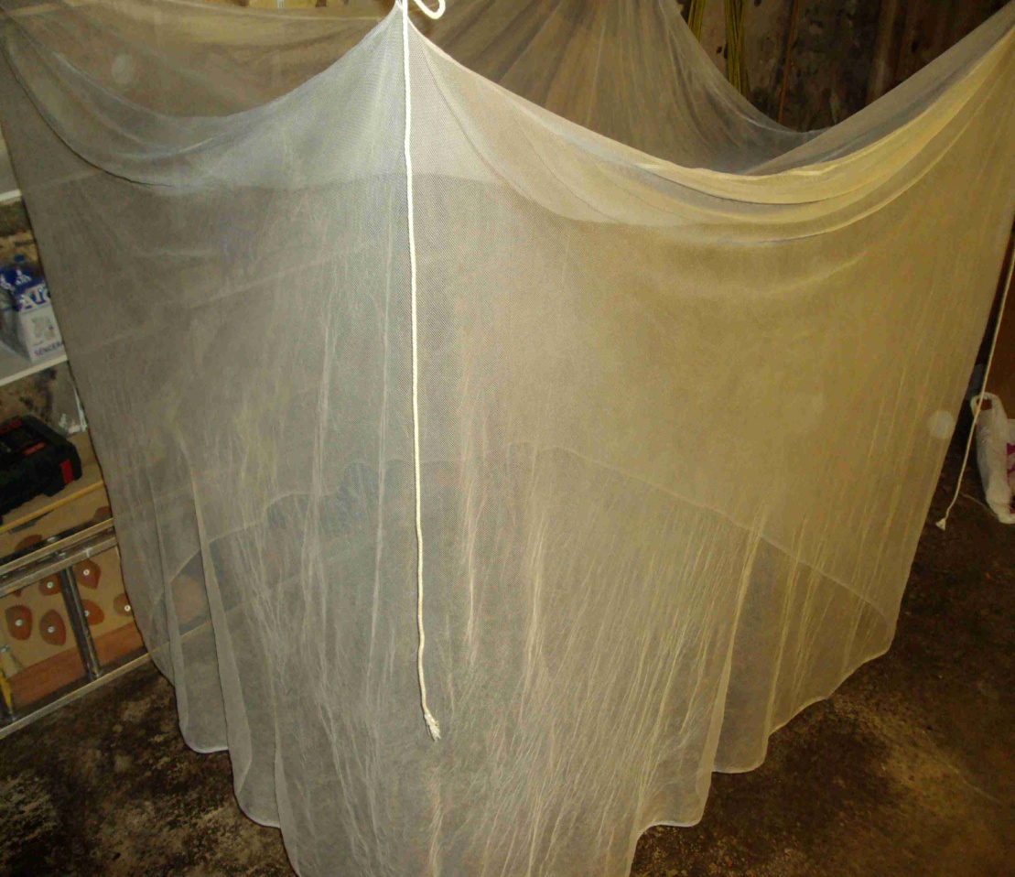
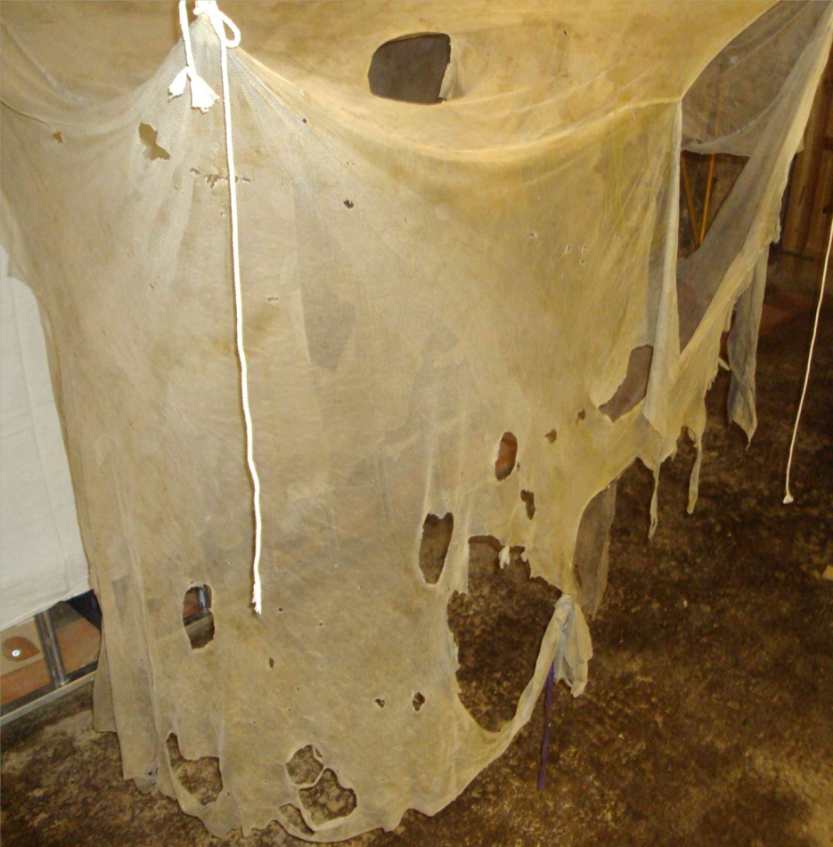
Net survival is highly variable
Two nets of same material & strength, regularly used, same place, same time (three years) Adapted from A. Kilian
Notes:
How many of us have nets in your household? The nets in your household and your neighbors households were they distributed at the same time. Do they look the same? Tell me about what you see in this net (first net). Show the second net. Tell me what you see in this net. Would you believe these nets were distributed at the same time in the same area? This is due to the causes of damage discussed in the last slide.

Slide 7
Campaigns only, no replacement
REMINDER AND SCENE SETTING
    The Importance of Continuous Distribution
Type 1
Type 2
Slide courtesy of A. Kilian
Notes:
Curve for nets distributed into the country. Data actually shows we lose this net along the curve. Type 1 is usual 3- year LLIN. Type 2 would be one that may come about in the future (longer lasting net than what we had) this is the curve if we could get nets to last longer (modeled line- better over time). Manufacturers create longer lasting nets, or behavioral interventions on care and repair.

Slide 8
Campaigns only
Type 1
Type 2
Slide courtesy of A. Kilian
Notes:
Campaigns, this is what we’ll have in Luapula with only campaigns. Do we want this or do we want to maintain coverage at a certain level? Ketty are you happy with this? No. Why not? We want to sustain at 80%, over three years, coverage drops. Strategic plan is to stay at least at 80%. Ask: What can we do to sustain this coverage??

Slide 9
Continuous Distribution Strengths
Continuous distribution systems make LLIN available:
  To those who need it
  When they need it
Notes:
Put a system in place that ensures people get what they need, when they need it.

Slide 10
Continuous Distribution Channels
Health facility-Based Distribution i.e., antenatal (ANC) and Expanded Program on Immunization (EPI) clinics
Community-based Distribution
Commercial outlets, such as retail shops and markets
Schools
Notes:
Has ANC happened? Has EPI happened before? Do we Shoprite and pharmacy shops stock them. Do you feel schools can be used?

Slide 11
Push and Pull
Continuous distributions should combine push and pull systems
Push
Demand driven
Push
Commercial market
Utilization of services gives access to LLIN
Community
  ANC
  EPI
  Schools
Family decides that LLIN needed
Routine service access driven
Pull
Pull
Notes:
Every woman who comes to ANC gets a net, whether she needs it or not. When they receive them, they keep them or share them. There are other people in the community who will need nets who are not covered by ANC/EPI—those people come when they need one. This pull system means there won’t be an oversupply.

Slide 12
Push and Pull
Push systems will oversupply LLIN if the allocation rule or service uptake is higher than true demand
Pull systems will find equilibrium
  If net culture is developed (BCC)
  If approaches included that give access to LLIN to lower wealth quintiles and difficult to reach population
Notes:
Need to build the net culture through BCC.

Slide 13
Objectives
What is continuous distribution?
What is the rationale behind adapting a continuous distribution strategy?
What are examples of continuous distribution channels?
Notes:
We’ve covered these things. And now I turn it over to Ato to give some specific country examples.

Slide 14
Thank you!

Slide 15


