Slide 1
Lessons learned from an assessment of the continuous LLIN distribution assessment in Nigeria
By Mr Okefu Oyale Okoko
Deputy Director/Head
Integrated Vector Management Branch
National Malaria Elimination Programme (NMEP)

Slide 2
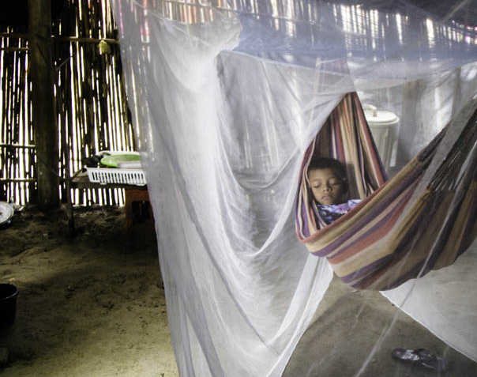
Outline
Findings from an assessment of the continuous LLIN distribution in Nigeria
Background
1
Study design
2
Results and recommendations
3

Slide 3
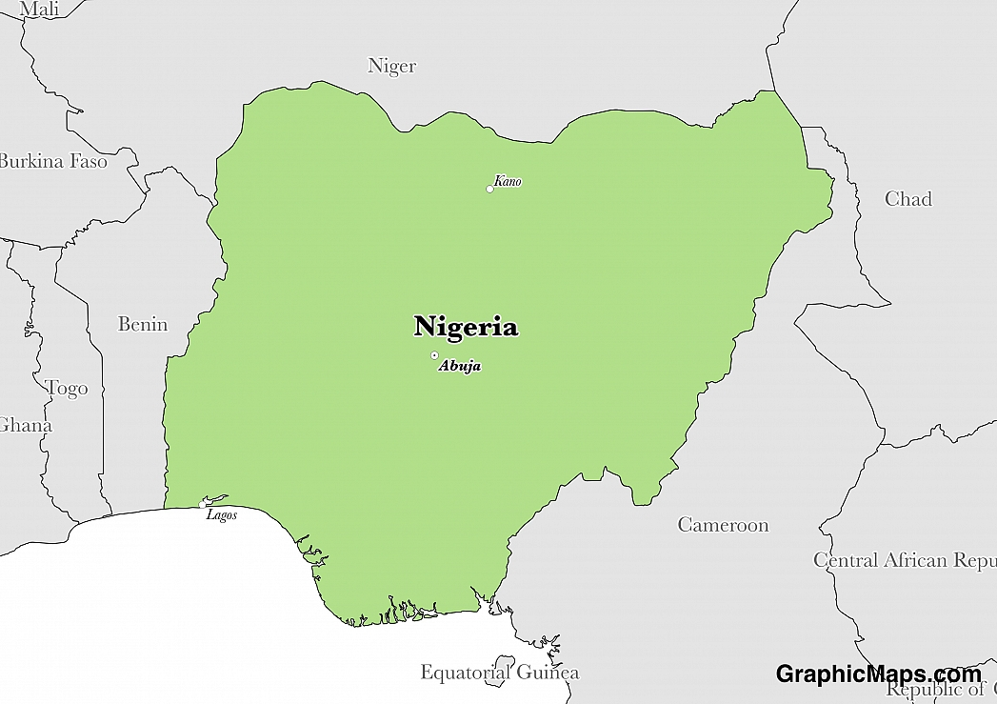
Country context
Nigeria is located on the western coast of Africa
A populous country with over 206 million people and an annual population growth rate of 2.5%
Map of Nigeria
Health indices
12% increase in the number pregnant women who had 4+ ANC visits) between 2013 and 2018
189% increase in the proportion of children under 5 years with fever given ACT between 2013 and 2018
31.1% increase in the number of children age 12-23 months who received 3rd dose of the Pentavalent vaccine
2013 and 2018 Nigeria Demographic Health Survey

Slide 4
Background
The IVM strategy in Nigeria consists of LLIN distribution as the main prevention strategy. The country is the world’s largest LLIN purchaser, with a population of 200 million
LLIN procurement in the country is done through funding support from donors (GF and PMI) and state funding, in areas not targeted for donor support
Nigeria conducts mass LLIN campaigns on a rolling basis in a 3-year cycle -64% increase in HH with at least one LLIN from 2010 to 2015
Continuous distribution of LLINs predominantly through ANC and Routine Expanded Programme on Immunization (EPI)
However, not all clinics have ANC or immunization programs, thus limiting the access of LLINs in some regions
NMEP with support from CHAI conducted a continuous LLIN distribution assessment across the states of Nigeria to understand the CD landscape and identify distribution challenges
This presentation summarises key findings from the assessment and proposed recommendations
¹2010 and 2018 Nigeria Demographic Health Survey
Notes:
Nigeria conducts their mass LLIN campaigns on a rolling basis in a 3-year cycle. The 2018 DHS results show that nationally, 60.2% of surveyed households have at least one ITN, but only 29.5% of households having at least one ITN for every two persons who stayed in the household the previous night.
Routine distribution is conducted predominantly through ANC and Routine Expanded Programme on Immunization (EPI). However, not all clinics have ANC or immunization programs, so it is necessary to quantify which are the routine distribution channels for LLINs

Slide 5
The assessment was conducted across all states in Nigeria to provide an overview of the routine LLIN distribution landscape and gaps
The survey aims to:
Describe routine LLIN distribution in terms of channels used and challenges encountered
Determine quantification and stock management practices of routine LLIN distribution
Identify gaps in the availability of human resources for routine LLIN distribution
Identify gaps in the surveillance, M&E of routine LLIN distribution
Study design
Target population
Data collection
Data Analysis
A cross-sectional survey conducted in all the 36 states of Nigeria and FCT
Survey was administered to at least one member of the state level VC team
Key informants were selected by the Head of IVM at the national level
Data was collected via a questionnaire in Google Forms.
Validation rules were built into the questionnaire to minimize errors in completing the survey
Questionnaire data was extracted from Google Forms, cleaned and analyzed in Stata 13 and Excel

Slide 6
Key Takeaways from the assessment (1/4)
Key concept
Findings
Routine LLIN assessment respondents
29 out of the 37 states completed the assessment google form
Job titles of respondents where; malaria program officers (72%), vector control focal person (8%) and Other (18%). The ‘other’ cluster comprised mostly of procurement and supply officers (PSM), program manager and MEP officer etc
Majority of states that responded to the survey are self-funding (n=17), the remainder are donor supported(n=12)
1
2
90% of states agreed that insufficient net supply to meet state requests/need was the greatest challenge for both donor funded and self-funding states
50% of states across all donors also reported insufficient training and insufficient planning data to calculate state LLIN needs as a challenge
Other challenges reported by states include, misuse of nets and limited SBCC (mostly by self-funding states)
76% of states reported delays in receiving routine LLINs from national level, with the major reason cited being delay in procurement at national level (50%)
Routine LLIN distribution challenges
Notes:
LLIN distribution challenges
Furthermore, challenge of nets insufficiency was corroborated by 67% of states that suggested improved availability of nets as a solution to improving distribution

Slide 7
Key Takeaways from the assessment (2/4)
Key concept
Findings
Planning for routine LLIN distribution
3
76% of states reported having a state level routine LLIN strategy document in place
49% of states responded that the state or LGA leadership are responsible for planning routine LLIN distribution, and 41% reported stakeholder or partner being responsible
95% of respondents reported use of ANC and routine immunisation as channels for continuous net distribution. The next frequently reported channel in use was community-based 27%
When asked which channel has been most effective at increasing LLIN coverage in your state, 68% responded community-based channel Fig 1

Slide 8
Key Takeaways from the assessment (3/4)
Key concept
Findings
4
Quantification for routine LLIN campaigns
Only 65% of states (across all donors) reported using a tool fig 2 to assist with quantification. No quantification tool or process was clearly preferred among states or necessarily in regions
Although the quantification frequency varied across states and regions, most states reported annually.
States that indicate no shortages tend to conduct quantification bimonthly
Less than 50% of states reported having a digital stock management system,
Having a digital stock management system in place did not appear to significantly impact whether a state reported having insufficient nets was a challenge to distribution.
Reported insufficient net as a challenge
Did not report insufficient net as a challenge

Slide 9
Key Takeaways from the assessment (4/4)
Key concept
Findings
CD surveillance and M&E
5
92% of respondents reported collecting number of LLINs distributed, only 3% reported collection of demographic data fig 3 Data is stored in DHIS2
32% responded that the data is not sufficient for planning.
Less than 50% of states across all donors reported use of electronic data collection tools.
25 states (mostly self-funded 68%) reported conducting data review meetings on CD LLIN data, frequently conducted quarterly (48%) and monthly (25%)
86% of respondents confirmed support and supervision of CD delivery points. Frequency of S&S visit varied the most in self-funded states whilst the frequency reported for donor supported states was quarterly

Slide 10
Recommendations
Key concept
Recommendations
LLIN routine distribution
Explore state tailored LLIN CD channels that increase LLIN coverages and improve targeting of vulnerable groups in the community
Further analysis on state specific root causes of insufficient nets should be conducted
Strengthen the supply management systems for routine LLIN distribution –e.g., timeous procurement
Provide more training for staff on key topics of routine LLIN distribution
LLIN distribution challenges
Surveillance of routine LLIN distribution
Review CD LLIN data reporting elements to ensure information collected enables states to adequately express LLIN needs, identify gaps and account for CD LLINs
Upscale electronic data capturing across the states to track routine LLIN campaign progress
Quantification of LLINs and stock management
Standardize quantification process including tools and frequency that can significantly reduce stock out of LLINs and assist with planning
Review and upscale the digital stock management system across the states

