Slide 1

FIELD ASSESSMENT OF THE FACILITY (RCH) AND COMMUNITY ITN DISTRIBUTION CHANNELS IN ZANZIBAR
Presenter:
Mwinyi Khamis
Head SBCC/ITNs Unit
Zanzibar Malaria Elimination Program
18th November, 2021

Slide 2
Presentation Outline
Introduction
Assessment objectives
Assessment methodology
Results and recommendations

Slide 3
Introduction
Zanzibar Malaria Elimination Program (ZAMEP) launched CD/RCH ITNs distribution in 2014
  180 HFs
  388 Shehia (wards)
The objective of CD was to maintaining ITNs coverage and protecting people from getting malaria infection by proper use of ITNs
The distribution scheme is supported technical by USAID Vector Control Activity (TVCA) Project Tanzania
The distribution scheme (RCH & community channels) has been assessed periodical to determine its progress
The assessment was carried out when TVCA took over ITNs-related activities from VectorLinks
This was done to enable effective and efficient implementation of RCH and community channels in Zanzibar

Slide 4
Objectives of the Assessment
To document challenges and opportunities for improvements in implementation of RCH and community ITN distribution at all levels
  National
  District
  HFs
  Shehia (ward)
Specific areas of implementation of ITN distribution assessed:
  Coordination & oversight
  Supply chain management
  Record keeping and reporting
  Supportive supervision for entire distribution scheme

Slide 5
Assessment Methodology
Combination of qualitative rapid investigation methods –
  Documents (desk review,
  key informant interviews
  and fact checking
Sampling:
  Assessment conducted in four districts
    2 in Unguja and 2 in Pemba
    Rural and urban districts were selected
  3 Health facilities were randomly selected in each district
  By using HMIS ITNs distribution data (October 2019 to September 2020) 3 categories of health facilities were selected
    high performance
    average performance
    low performance
Notes:
Health facility performance were ranked as high, average and low performers. High performers were those facilities with no or at least one month discrepancies in their Data for ITNs supplied and Issued for the past one year. Average performers were those with supply and issuing data discrepancies in 2 to 4 months for the entire period while Low performers were those with more than five months discrepancies for the ITNs supplied and Issued for the same period.

Slide 6
Assessment location
Zone | District | Health facilities selected
 |  | High performers | Average performers | Low performers
Unguja | South | Kizimkazi Dimbani PHCU | Kajengwa PHCU | Muungoni PHCU
 | Central | Chwaka PHCU+ | Pongwe PHCU | Bambi PHCU
Pemba | Mkoani | Kiwani Tasini PHCU | Ukutini PHCU+ | Wambaa PHCU
 | Micheweni | Kifundi PHCU | Wingwi PHCU+ | Micheweni Cottage

Slide 7
Results and Recommendations
Assessment Area | Observations | Recommendations
Coordination & oversight | Planning and coordination meetings not conducted If conducted, there is no documentation of meetings | ZAMEP to establish a national coordination team that will plan regular routine meetings on ITN distribution
 | Good government structure for ITNs distribution activities. Shehas are bias in coupon issuance to beneficiaries for community-based ITN distribution | Review community ITN distributions to exclude Shehas or coupons
 | Councils did not review ITN orders from health facilities ZAMEP approves ITN orders As a result, majority (5/6) of HFs visited in Pemba do not have coupons, though coupons are available at CMS Unguja | Restore the reporting, ordering and approvals through eLMIS i.e. councils review orders and CMS to approve orders
 | Some health personnel at national level were not knowledgeable of the processes for community-based ITN distribution | Reorient all personnel at national level on all processes and activities for community-based ITN distribution

Slide 8
Results and Recommendations
Assessment Area | Observations | Recommendations
Supply chain management | ITN storage spaces generally meet required standards at national and health facility levels. Only 1 HF visited (Bambi PHCU) had a dirty and untidy store. Stores for ITNs in 3 HFs (Bambi, Chwaka and Micheweni) were not secured | CHMTs/DPHARM to follow up with these facilities and rectify the situation. Maintain the standard in all HFs through supportive supervisions
 | In all HFs visited, staff were used Inventory Control Cards and other commodity management tools to effectively manage ITNs
 | More than 6 months of coupon stock outs in most health facilities in Pemba | CHMT/DMFP and DPHARM to use readily available mediums like phone calls and WhatsApp to regularly follow up on ITNs and coupon stock status at health facilities

Slide 9
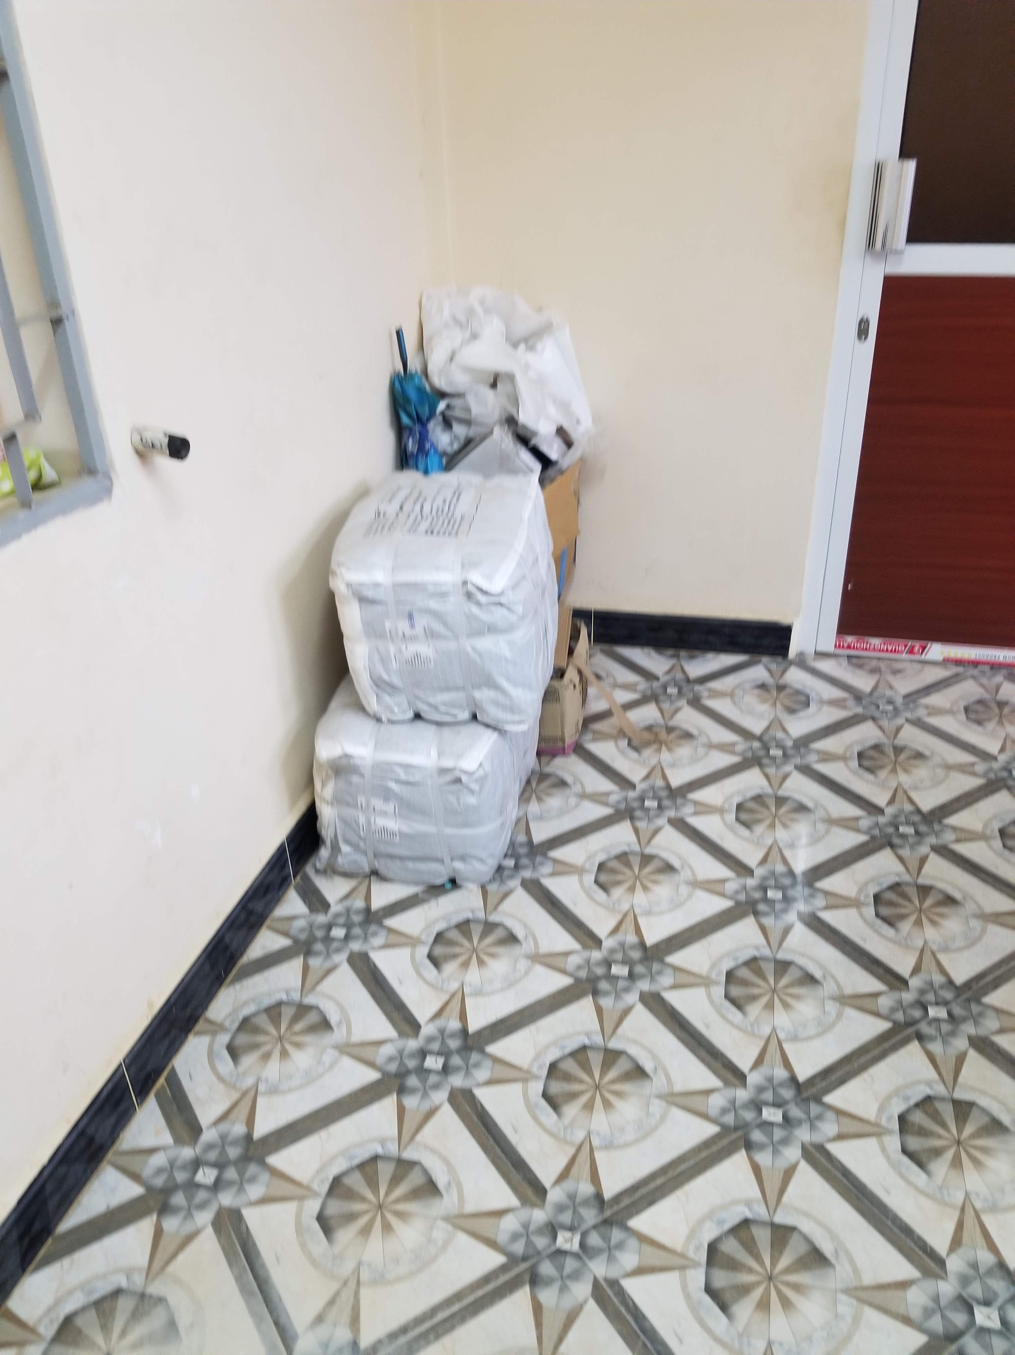
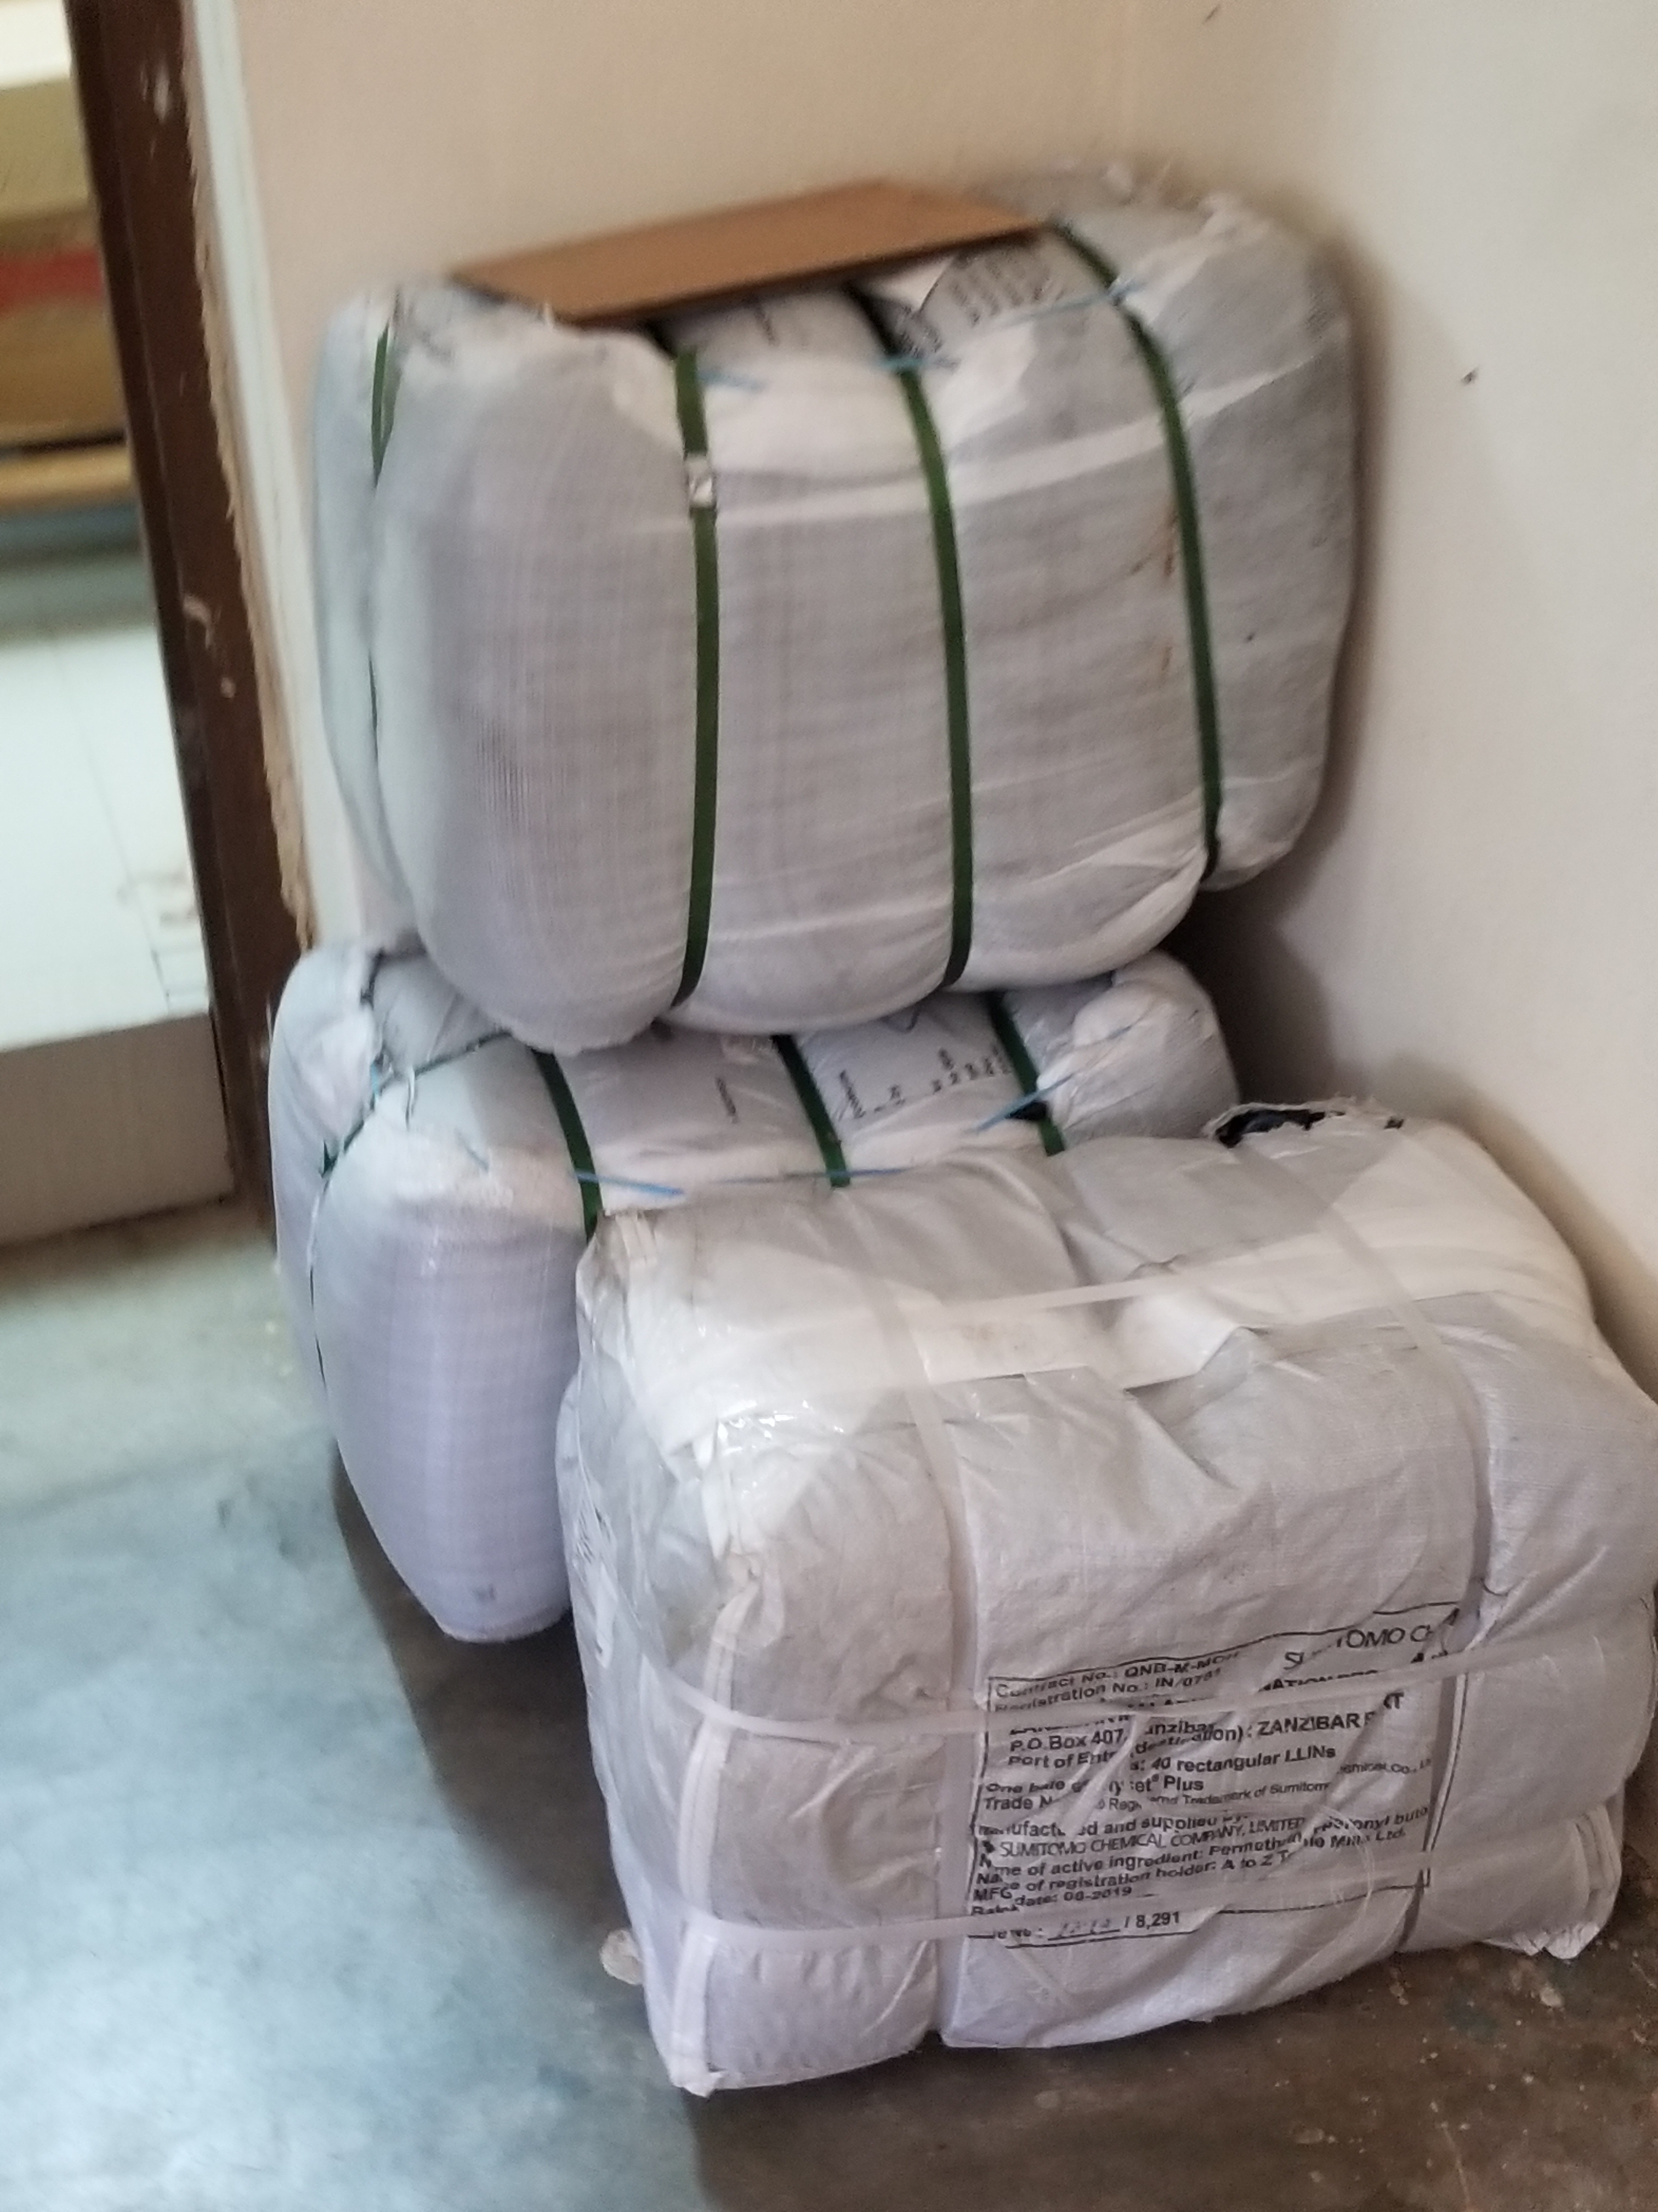
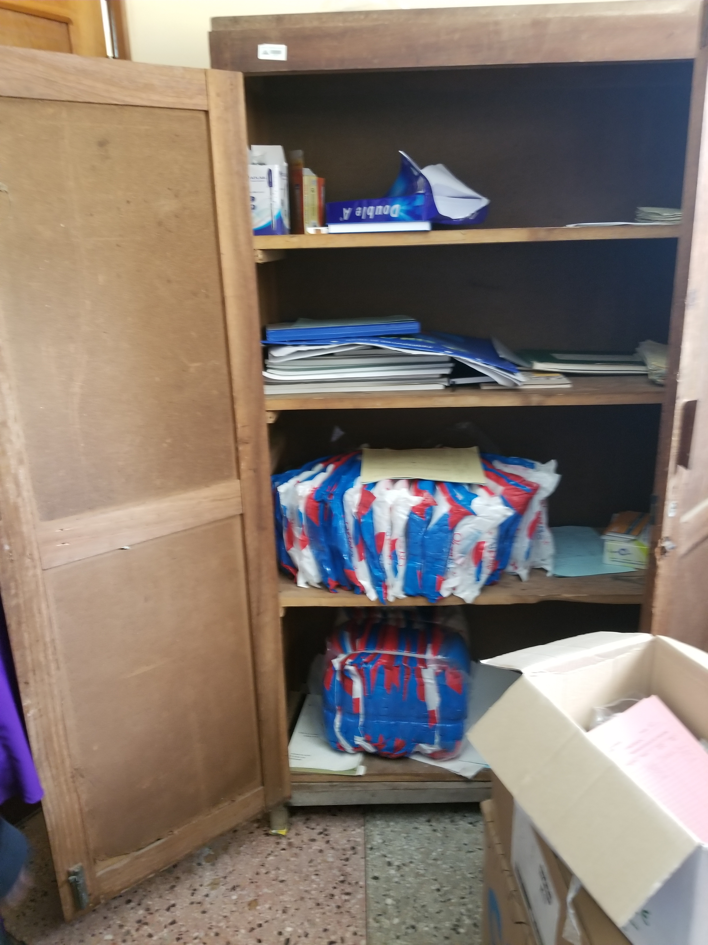
Good Examples – ITN Storage

Slide 10
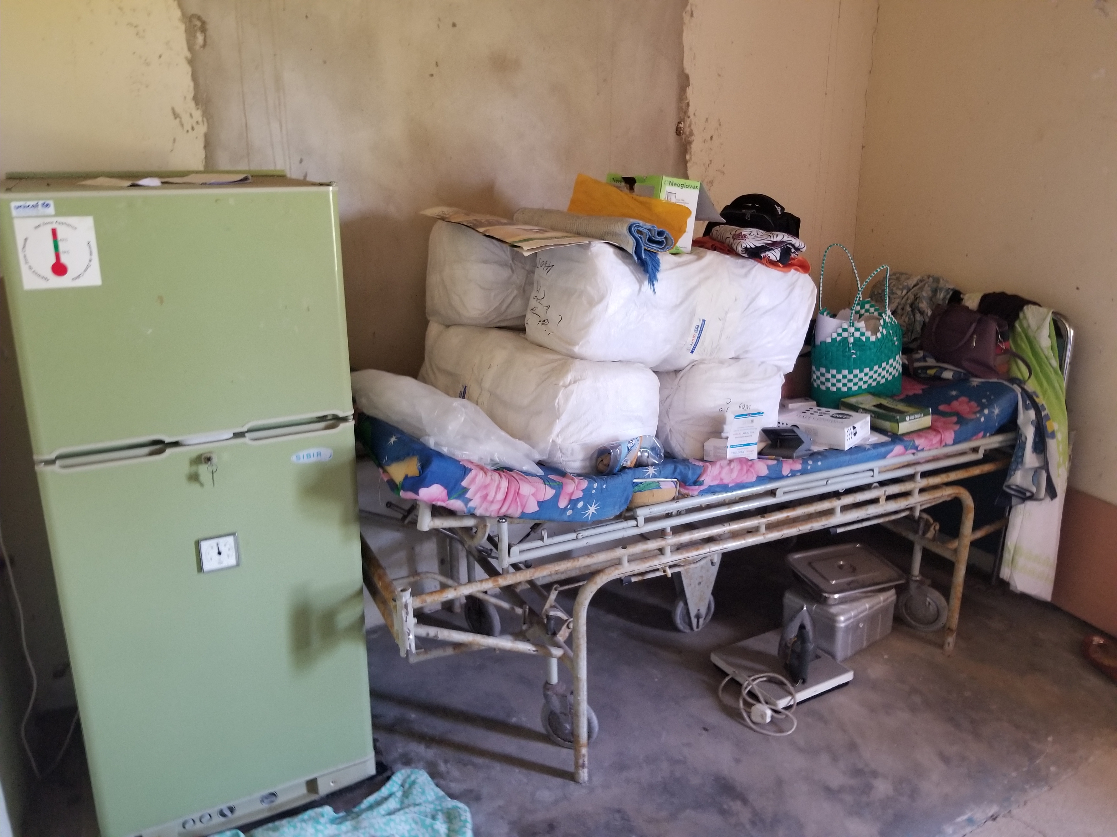
Poor Examples – ITN Storage

Slide 11
Results and Recommendations
Assessment Area | Observations | Recommendations
Record keeping and reporting | All HFs visited had the required tools for documentation and reporting of ITNs issued to beneficiaries | The standard should maintained
 | There are challenges in some HFs with proper documentation and reporting of ITNs issued to beneficiaries | CHMTs to conduct refresher trainings for health workers on proper documentation and reporting
 | Majority of HFs visited are using old HMIS tools (ANC and Child registers) which do not have columns to document ITNs issued | TVCA to support distribution of the new ANC and Child registers

Slide 12
Results and Recommendations
Assessment Area | Observations | Recommendations
Supervision | Supervision is not conducted as planned due to limited resources
 | The Checklist does not include ITN indicators to be checked during supervision visits | TVCA to support ZAMEP, HMIS & LMU to include ITN indicators in existing Supervision Checklist for use during visits to districts and health facilities TVCA to support ZAMEP, HMIS & LMU to develop and print a Supervision Report Form
 | No supervision reports at the facilities except for TB and HIV supervision visits. Others who conduct supervision visits just state their name and purpose in the Visitors’ Book when they visit

Slide 13
Feedback from focus group with Shehas & beneficiaries
Shehas
  Shehas reported that the community channel worked well and there were no any challenges.
Beneficiaries
  Community members complaints on coupon distribution bias from Shehas.
  Some health facilities have specific days for issuing ITNs through community channel.

Slide 14
Recommendations - Revised Community Channel Processes
ITNs to be issued at RCH
Community Health Volunteers (CHVs) to replace Shehas
The community health guideline has been revised and identify the roles of CHV including ITNs distribution
Some of CHVs are already trained under the GF fund and D-Tree under the supervision of Health education program of MOH

Slide 15
Recommendations - Revised Community Channel Processes
CHVs training package including
  Identifying health and health related problems at HH level
  Using mobile Apps. for health counselling at household level
  House to house community sensitization to increase awareness on utilization of public health services
  Referring of complicated
In advance way the TVCA will explore the use of mobile device
  Introduction of E-coupons
  Linked data with DHIS2

Slide 16
Thank you very much

