Slide 1
Vector Control in Humanitarian Settings Update and Case Study Launch.
Joseph Lewinski- AMP IEWG | CRS
Dana McLaughlin- UN Foundation
Jessica Rockwood- AMP IEWG | IPHA
Jim William Wirngo- PMI Cameroon
Sajid Kamal- Mentor Initiative South Sudan
October 12th 2022

Slide 2
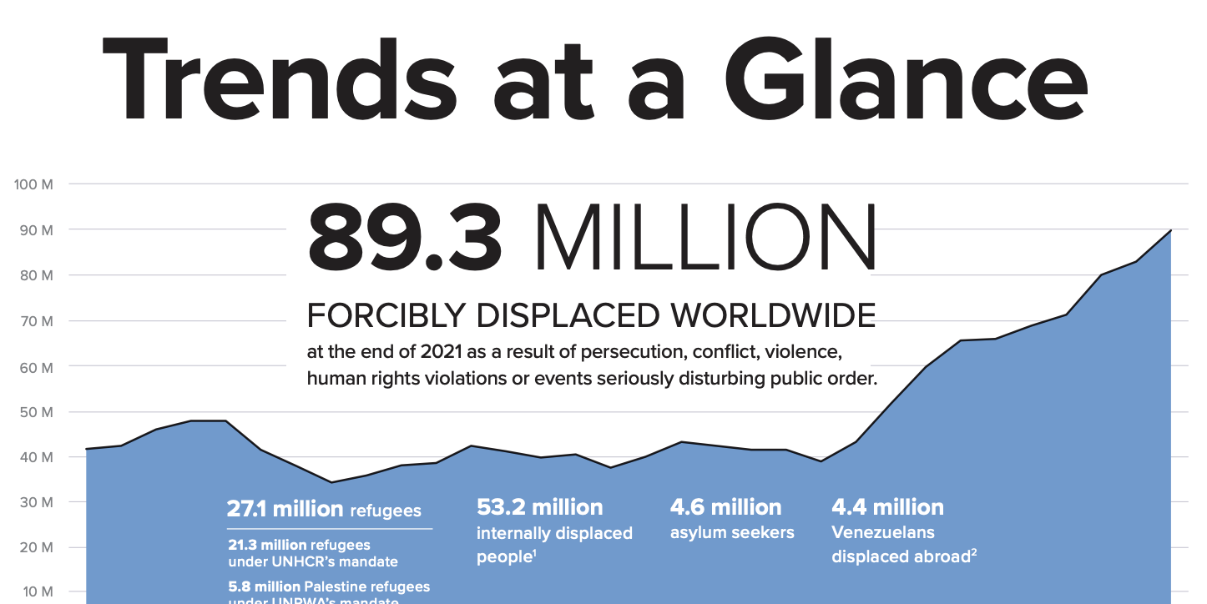
UNHCR Report 2022

Slide 3
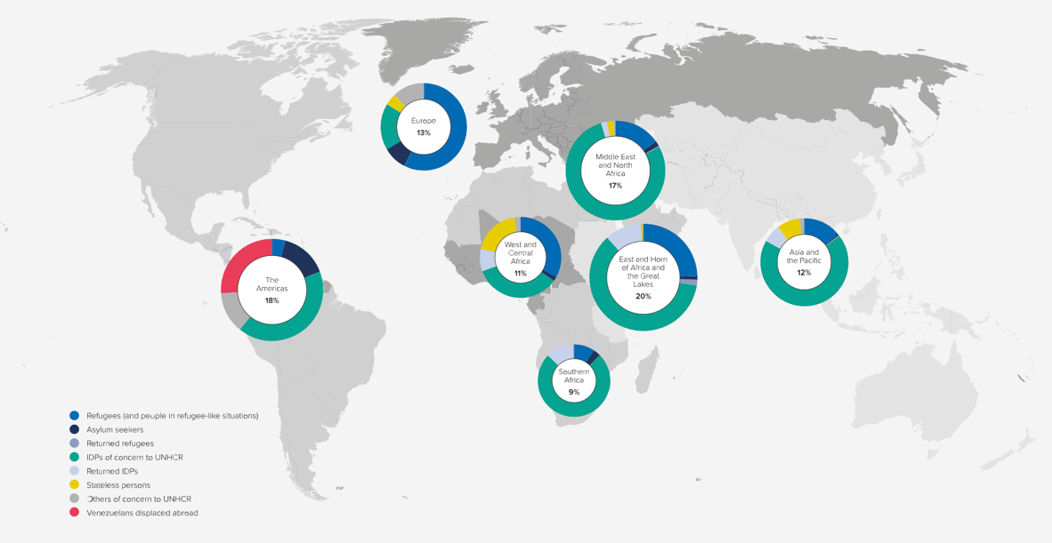
40% of Displacement in Sub-Saharan Africa
UNHCR Report 2022

Slide 4
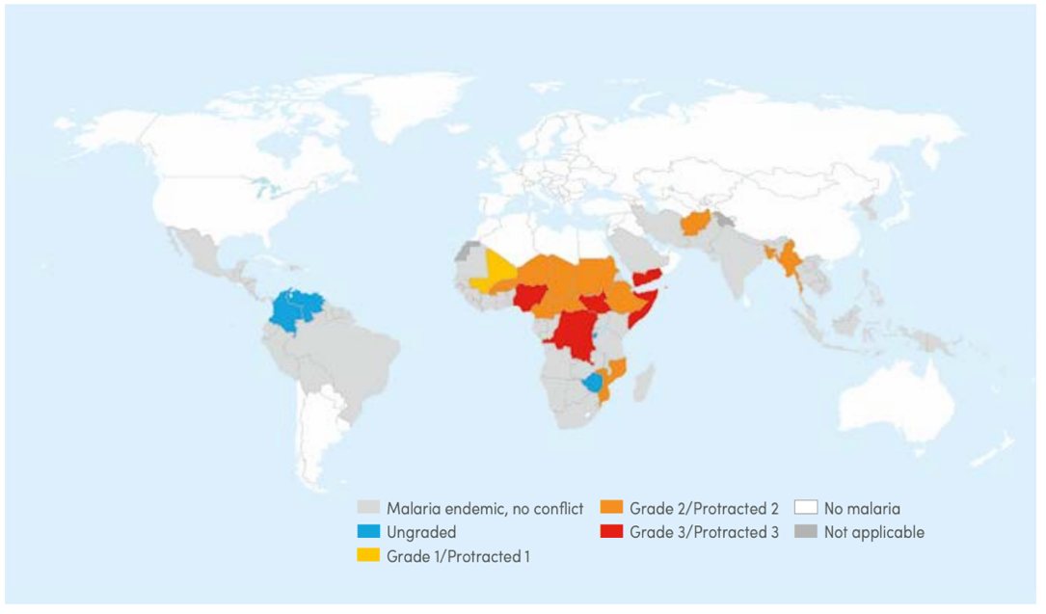
Map of ongoing armed conflicts as of October 2021
World Malaria Report 2021

Slide 5
Relative population exposure to 15 cm or more flood inundation risk
World Malaria Report 2021

Slide 6
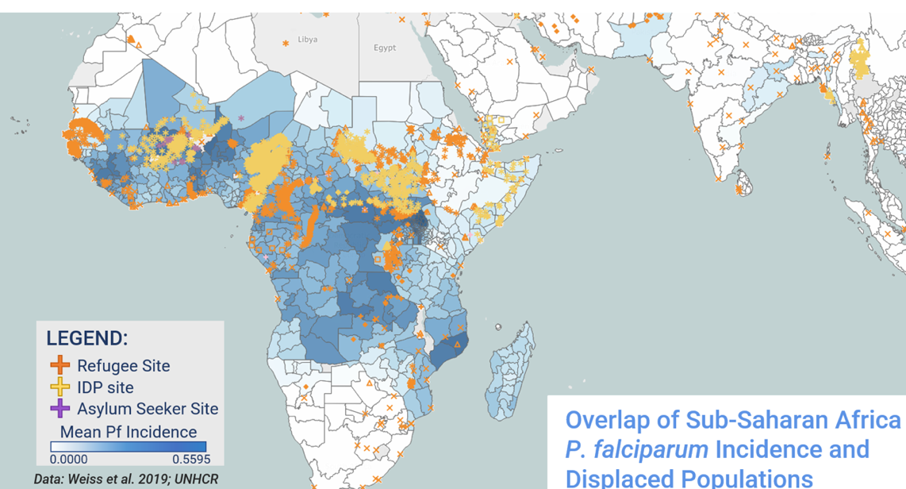

Slide 7
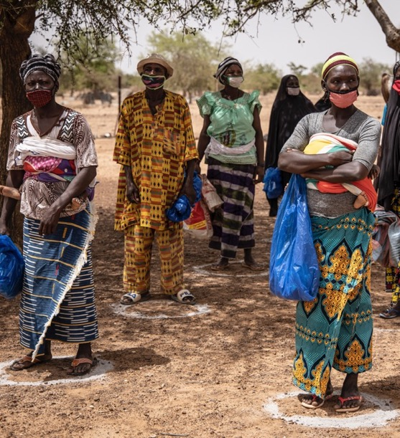
Challenges Remain
Funding gaps meant a lack of support for malaria prevention in some locations, leading to higher rates of sickness and increased mortality due to malaria.
UNHCR Report 2021

Slide 8
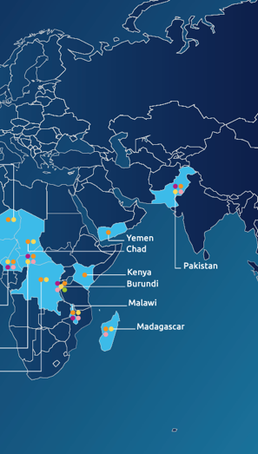
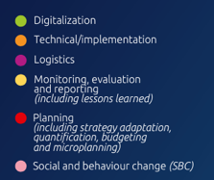
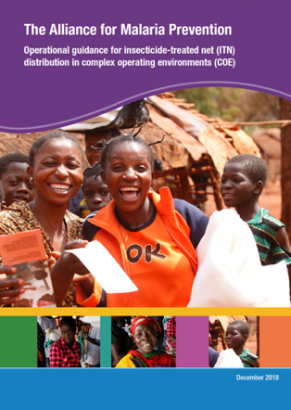
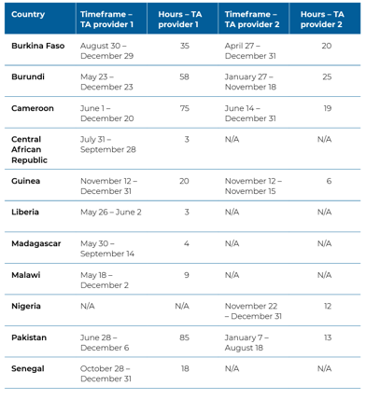
AMP Initiatives to Date

Slide 9
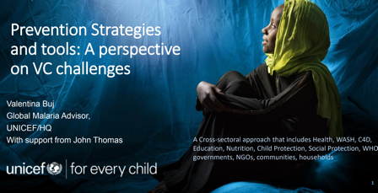
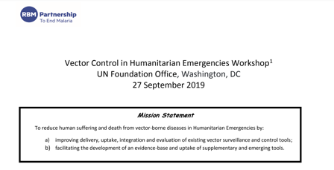
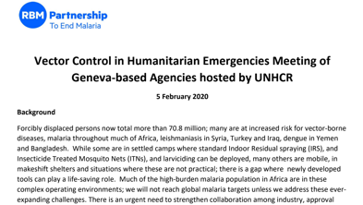
Global Initiatives to Date

Slide 10
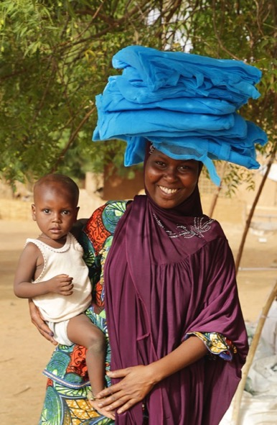
Roundtable Objectives
Outline opportunities to engage and promote better cross-sector coordination on vector control in emergency/humanitarian crisis and response
Ensure partners and countries continue to address the bottlenecks that frequently delay the delivery of vector control commodities to populations facing conflict, forced displacement, or disaster
Identify funding and opportunities to ensure consistent and high coverage of appropriate and novel vector control tools

Slide 11
Key Roundtable Takeaways
The re-emergence of disease reflects the low quality and poor continuity of services in complex operating environments
Financing mechanisms are needed that are adaptive and responsive to meet evolving challenges
Too often, people’s health is at risk because of the design of the physical shelters that they live
Disaggregated refugee and IDP data are extremely rare.
‘Zero dose children’ and the communities where they live are the same communities with limited access to all malaria control measures.
Tracking the flow of resources for humanitarian and conflict settings is hugely complex.
Notable challenge of sustaining Community Health Workers (CHWs) in COE settings.

Slide 12
Webinar Agenda
Overview and Outcomes of Roundtable 1
Demonstration on new UNF Malaria Displacement Maps|
Launch of Case Studies + Country Highlights
Northern Cameroon
South Sudan
Update from Mozambique + Uganda
Q&A
Next Steps Future Roundtables
Open Discussion on Process and Pathways Forward

Slide 13
Welcome | Bienvenue |Bem-vindo

