Slide 1
Vector Control in Humanitarian Settings Update and Case Study Launch.
Joseph Lewinski- AMP IEWG | CRS
Dana McLaughlin- UN Foundation
Jessica Rockwood- AMP IEWG | IPHA
Jim William Wirngo- PMI Cameroon
Sajid Kamal- Mentor Initiative South Sudan
October 12th 2022

Slide 2
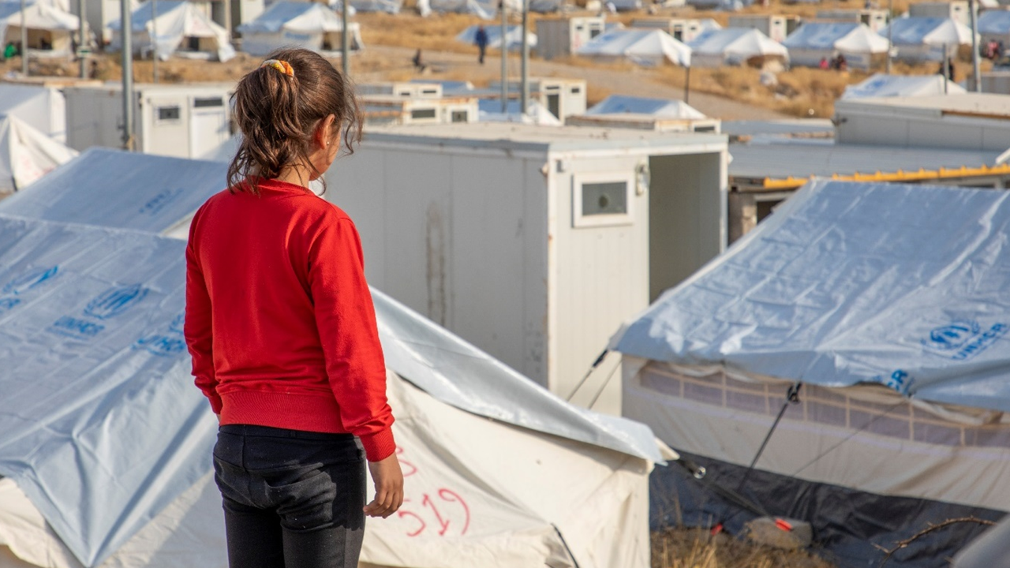
Assessing Inclusion of Displaced Populations in Global Fund Applications
Update on September 20, 2022
Image: UNHCR
Notes:
Leave no one behind is the central, transformative promise of the 2030 Agenda for Sustainable
Development and the Sustainable Development Goals. However, many disease elimination and
eradication programs, from polio and measles to malaria, face challenges in reaching and prioritizing
marginalized, migrant, and last-mile populations, making the tail-end of elimination programs more
costly, fragmented, and complicated.

Slide 3
Background
Engagement Goals
The Global Fund to Fight AIDS, TB and Malaria provides a significant proportion of international funding for HIV/AIDS, malaria, and TB. Much of this funding is invested in countries that host large displaced populations.
This analysis examines the inclusion of refugees and IDPs in Global Fund funding requests for the 2020-2022 funding cycle
Update of previous analysis examining the inclusion of refugees and IDPs in Global Fund concept notes (2014-2016) and funding applications (2017-2019) – Results available here
Methodology adapted from Spiegel, et al. Conflict-affected displaced persons need to benefit more from HIV and malaria national strategic plans and Global Fund grants. Conflict and Health 2010, 4:2
3
Notes:
WHO’s Global Technical Strategy for Malaria (2016-2030) is centered on the principle of equity.
However, core malaria donors and National Malaria Control Programs have just begun to prioritize and
fund targeted malaria activities for migrant, marginalized, and last-mile populations.

Slide 4
Methods
Engagement Goals
Eligibility:
Countries that qualify for GF allocation at time of application
Countries with at least one approved grant
Refugee/IDP population greater than 10,000 at time of application
Keyword search terms:
Refugee
Internally displaced person
IDP
Returnee (classified as refugees)
Displaced
Displacement
Mobile (exclude nomadic, semi-nomadic, migrant)
Asylum
Venezuelan
Humanitarian conflict
Noncitizen
People/person of concern
Foreigner
Stateless
* Replace person with "population" or "people" where appropriate
Study Size:
Refugee analysis – 100 applications, 37 countries
IDP analysis – 107 applications, 40 countries
Scoring: Based on keyword search, applications were labeled and scored
Activities – included specific activities that focused on refugees/IDPs
Mention – mentioned their population of refugees/IDPs but did not specify activities
No Mention – no mention of the refugees/IDPs
4
Notes:
Analyzing mention and listing of activities for refugees and IDPs in funding requests is an imperfect proxy. Some countries may provide activities for these populations without mentioning them in their applications.

Slide 5
Overall, refugee and IDP inclusion in GF applications has improved compared to the 2017-2019 funding cycle.
Cumulative Scores
5

Slide 6
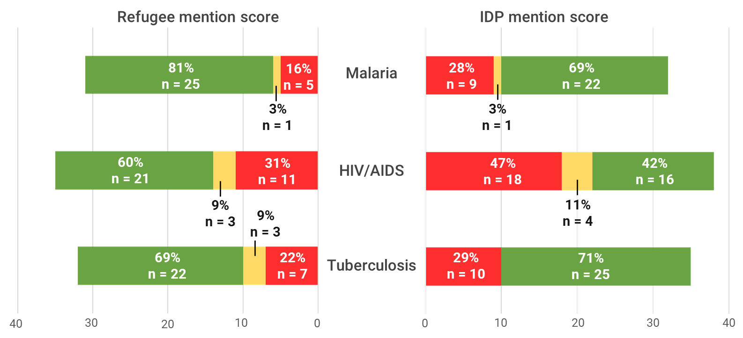
Of the three diseases, malaria applications had degree of inclusion of targeted interventions for refugees and IDPs.
Disease Specific Scores
6
Notes:
Since the last funding cycle:
Refugee and IDP mention has increased substantially
The number of applications mentioning displaced populations without detailing activities targeting them has decreased

Slide 7
Results:
Malaria
7

Slide 8
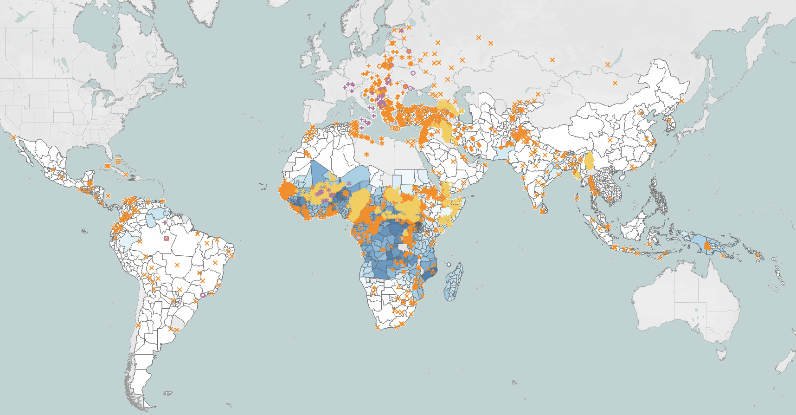
Overlap of Global P. falciparum Incidence and Displaced Populations
LEGEND:
Refugee Site
IDP site
Asylum Seeker Site
Mean Pf Incidence
0.0000
0.5595
Data: Weiss et al. 2019; UNHCR
8

Slide 9
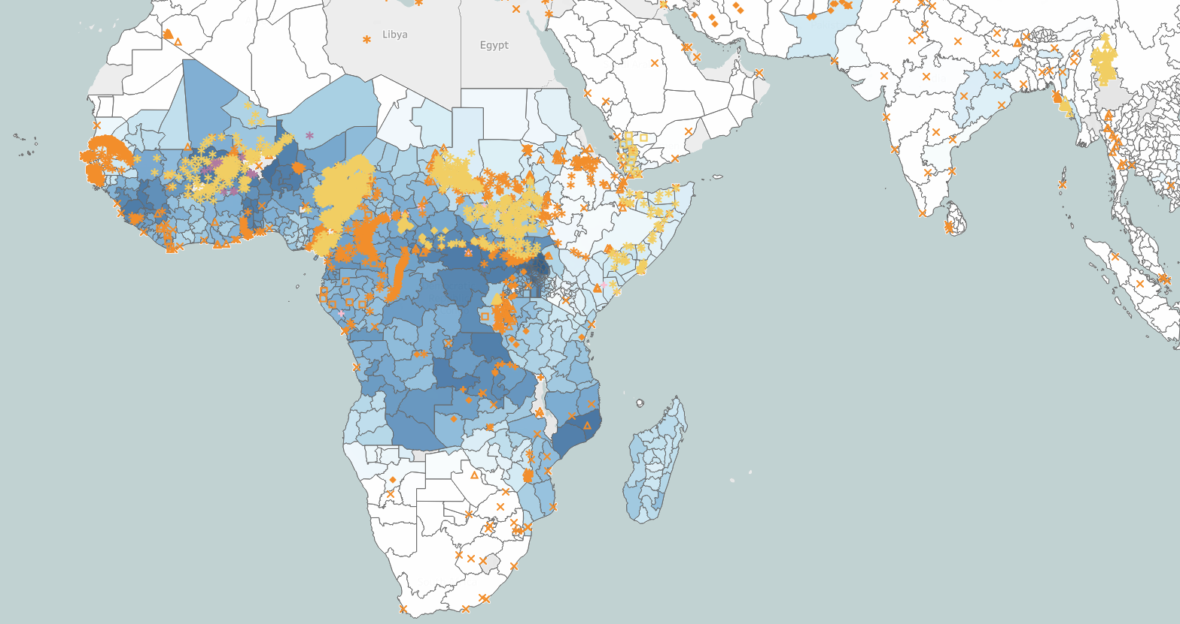
Overlap of Sub-Saharan Africa P. falciparum Incidence and Displaced Populations
Engagement Goals
LEGEND:
Refugee Site
IDP site
Asylum Seeker Site
Mean Pf Incidence
0.0000
0.5595
Data: Weiss et al. 2019; UNHCR
9

Slide 10
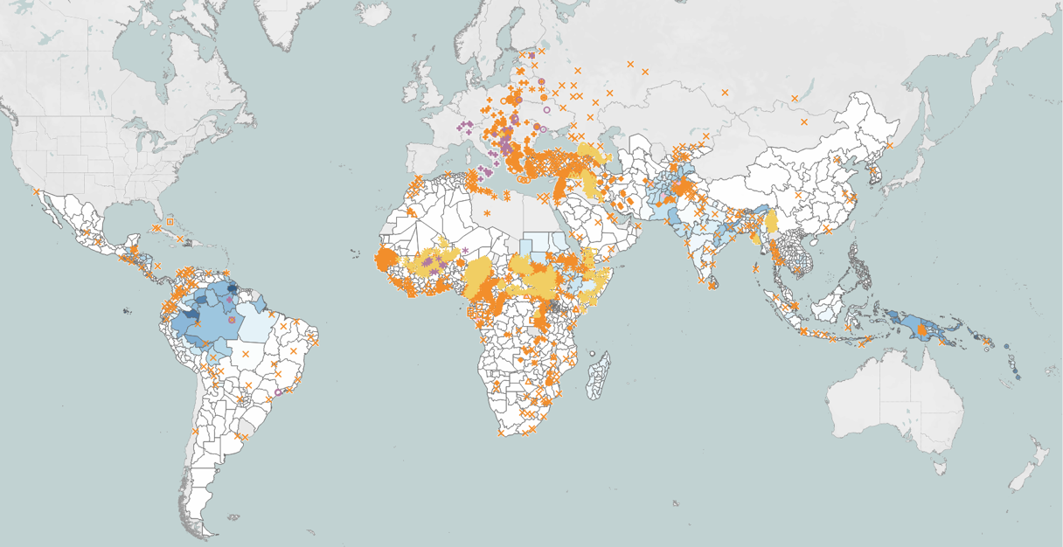
Overlap of Global P. vivax Incidence and Displaced Populations
LEGEND:
Refugee Site
IDP site
Asylum Seeker Site
Mean Pv Incidence
0.0000
0.1671
Data: Weiss et al. 2019; UNHCR
10

Slide 11
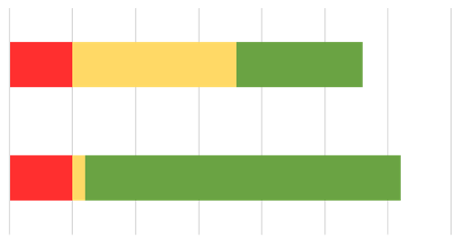
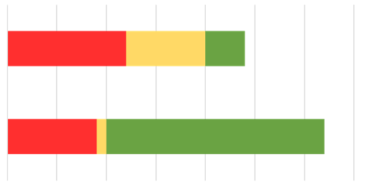
Refugee and IDP inclusion in malaria funding requests has improved substantially.
Refugee mention score
IDP mention score
36%
n = 10
46%
n = 13
18%
n = 5
50%
n = 12
33%
n = 8
17%
n = 4
2017-2019
3%
n = 1
3%
n = 1
81%
n = 25
16%
n = 5
28%
n = 9
69%
n = 22
2020-2022
35
30
25
20
15
10
5
0
0
5
10
15
20
25
30
35
Since the last funding cycle:
Inclusion of specific activities for refugee and IDPs has increased substantially
Virtually no funding requests mentioned displaced populations without detailing targeted activities for them
11

Slide 12
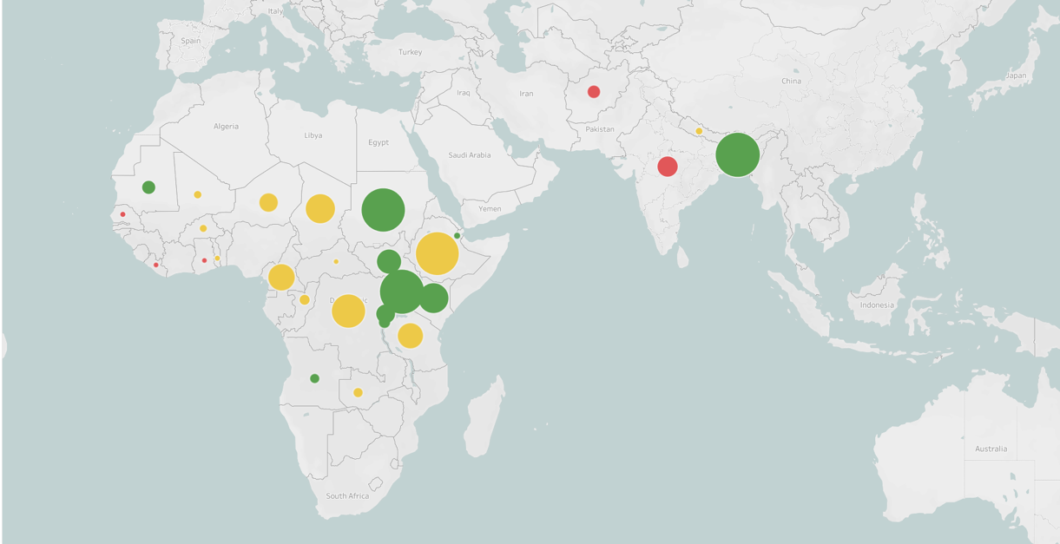
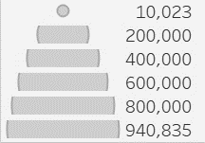
Malaria analysis 2017-2019: Refugee Mention and Population Size
LEGEND:
Population Size
Activities
Mention
No Mention
12

Slide 13
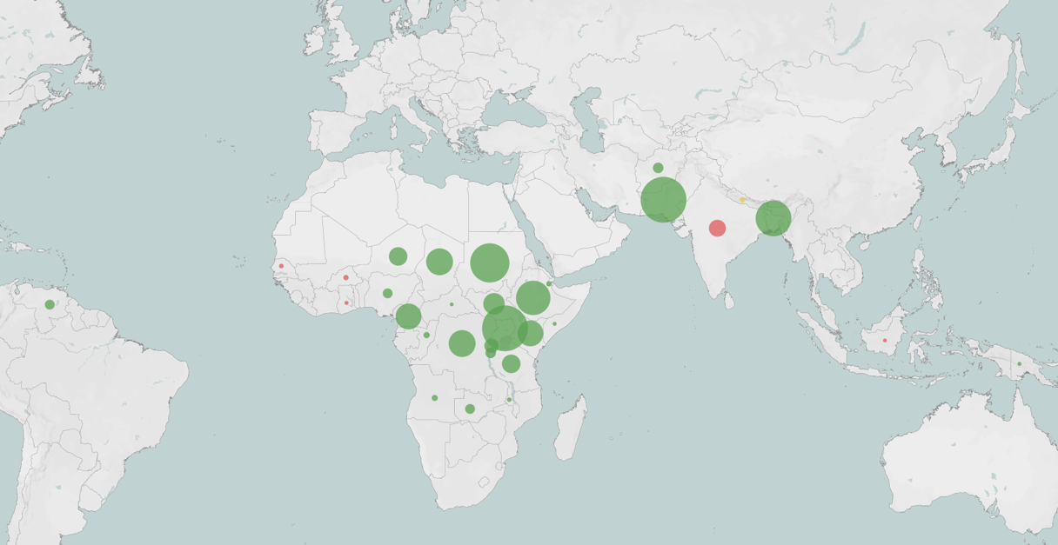
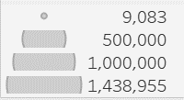
Malaria analysis 2020-2022: Refugee Mention and Population Size
LEGEND:
Activities
Mention
No Mention
Population Size
13

Slide 14
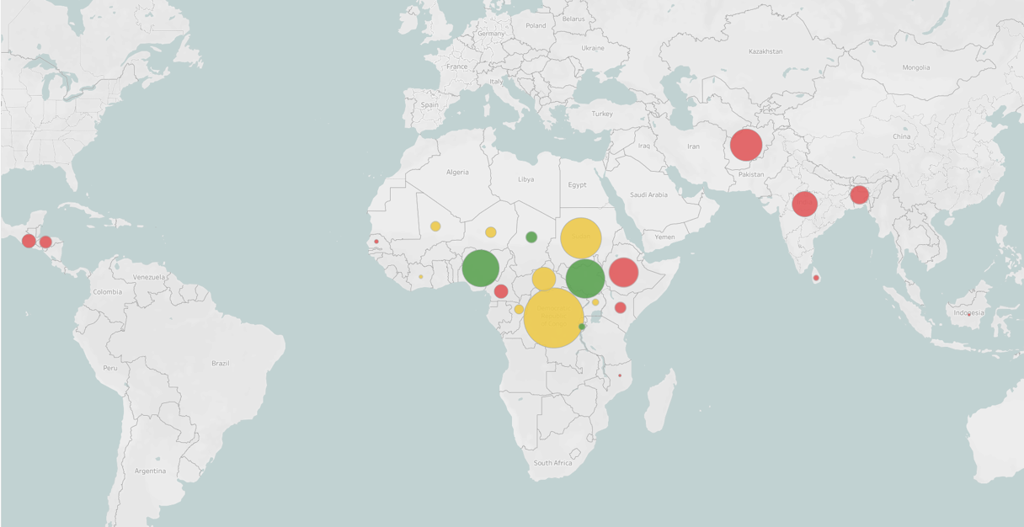
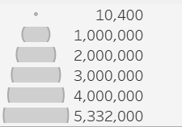
Malaria analysis 2017-2019: IDP Mention and Population Size
LEGEND:
Population Size
Activities
Mention
No Mention
14

Slide 15
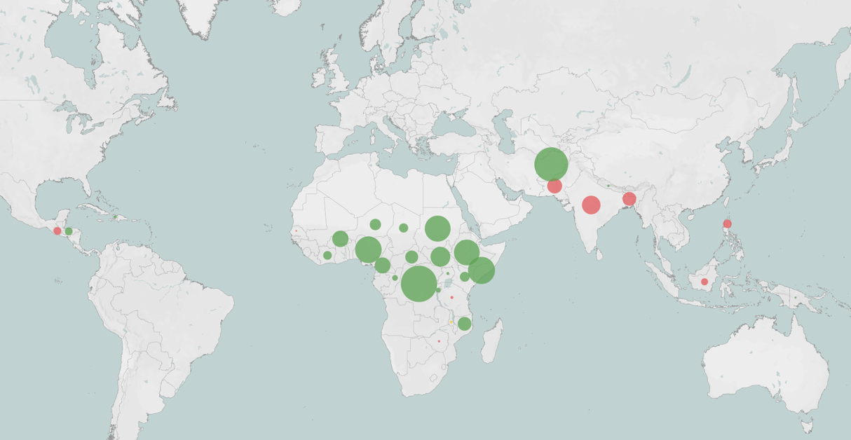
Malaria analysis 2020-2022: IDP Mention and Population Size
LEGEND:
Population Size
Activities
Mention
No Mention
15

Slide 16
Conclusions: Malaria analysis
Engagement Goals
Inclusion of both refugee and IDP populations in malaria funding requests has improved substantially since the previous analysis.
Though the proportion of countries not mentioning refugees in their malaria funding requests did not change, there was a notable decrease in the proportion of countries failing to mention IDPs
Much of the positive progress stems from an improvement in the proportion of countries that mention displaced populations but do not include specific activities for them in their malaria funding requests – only two of the 63 applications mentioned refugee and IDPs without detailing specific programming to address their needs
Most countries with very large refugee and IDP populations that were eligible for this study included specific programming for these populations in their funding request
16

Slide 17
West and Central Africa
Engagement Goals
Malaria
HIV/AIDS
Tuberculosis
 | 2017-2019 | 2020-2022 | 2017-2019 | 2020-2022 | 2017-2019 | 2020-2022
Burkina Faso
Chad
Cameroon
Côte d’Ivoire
Central African Republic
Ghana
Mali
Niger
Nigeria
Senegal
17
Notes:
| Burkina Faso | Chad | Cameroon | Côte d'Ivoire | Central African Republic | Ghana | Liberia | Mali | Niger | Nigeria | Senegal

Slide 18
Eastern Horn of Africa and Great Lakes
Engagement Goals
Malaria
HIV/AIDS
Tuberculosis
 | 2017-2019 | 2020-2022 | 2017-2019 | 2020-2022 | 2017-2019 | 2020-2022
Burundi
Djibouti
Ethiopia
Kenya
Rwanda
Somalia
South Sudan
Sudan
Tanzania
Uganda
18
Notes:
| Burundi | Djibouti | Eritrea | Ethiopia | Kenya | Rwanda | Somalia | South Sudan | Sudan | United Republic of Tanzania | Uganda

Slide 19
Southern Africa
Engagement Goals
Malaria
HIV/AIDS
Tuberculosis
 | 2017-2019 | 2020-2022 | 2017-2019 | 2020-2022 | 2017-2019 | 2020-2022
Angola
DRC
Malawi
Mozambique
Republic of the Congo
Zambia
Zimbabwe
19
Notes:
| Angola | Democratic Republic of the Congo | Malawi | Mozambique | Republic of the Congo | Zambia | Zimbabwe

Slide 20
Latin America and the Caribbean
Engagement Goals
Malaria
HIV/AIDS
Tuberculosis
 | 2017-2019 | 2020-2022 | 2017-2019 | 2020-2022 | 2017-2019 | 2020-2022
Guatemala
Haiti
Honduras
Venezuela
20
Notes:
Guatemala | Haiti | Honduras | Venezuela

Slide 21
The Middle East, Asia, and the Pacific
Malaria
HIV/AIDS
Tuberculosis
 | 2017-2019 | 2020-2022 | 2017-2019 | 2020-2022 | 2017-2019 | 2020-2022
India
Nepal
Papua New Guinea
Sri Lanka
21
Notes:
India | Nepal | Papua New Guinea | Sri Lanka

Slide 22
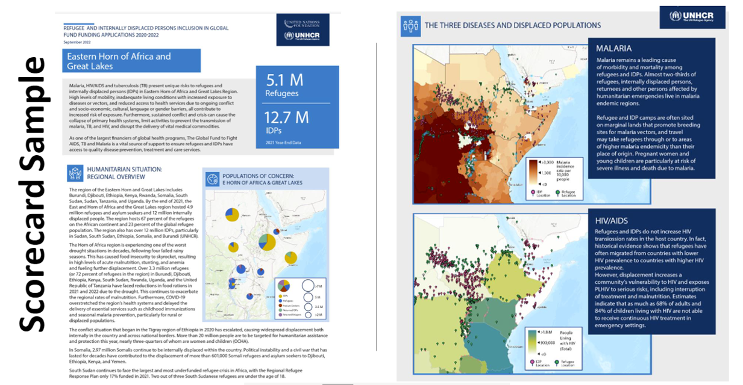
Notes:
We’ve developed six regional scorecards with specific summaries, maps, scores, and recommendations after completing the analysis of the 2020-2022 Global Fund funding notes to determine the inclusion of activities for refugees and IDPs,
In partnership with UNHCR, the Global Fund and partners from the three disease communities, we are planning to lead and support a series of workshops and presentations with country teams over the next six months to advocate for and facilitate the inclusion of disease-specific programs for refugees, IDPs, and other migrant populations in the next round of Global Fund grant applications.

Slide 24
Questions on overall initiative?

