Slide 1
REPORT ON ZAMBIA ITN ISSUING RATE (2021-2023)
AMP CDWG WEBINAR
OCTOBER 2, 2024
Presenters:
Ketty Ndhlovu-Sichalwe
Prince Owusu

Slide 2
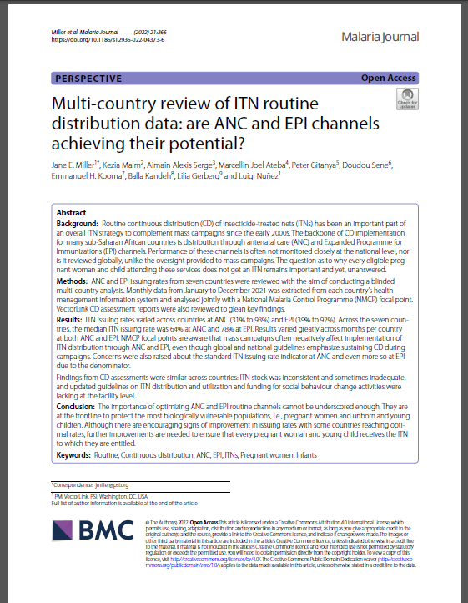
Multi-Country Data on Routine ITN Distribution
In 2022, PMI VectorLink conducted a multi-country review which showed that despite continuous distribution channels operating for over a decade, many countries still struggle to reach and maintain high issuing rates.
Issuing rate is a measure of the performance of the ANC and EPI channel and defined as the percentage of pregnant women at first ANC visit and children under 1 year receiving the first measles vaccine who also received an ITN).
A blinded multi-country analysis of routine Antenatal Clinic and Expanded Program on Immunization (ANC/EPI) data.
Monthly data from January-December 2021 was analysed.
Data was from seven country’s HMIS and analysis was jointly conducted with NMPs.
Notes:
Miller, J.E., Malm, K., Serge, A.A. et al. Multi-country review of ITN routine distribution data: are ANC and EPI channels achieving their potential?. Malar J 21, 366 (2022). https://doi.org/10.1186/s12936-022-04373-6

Slide 3
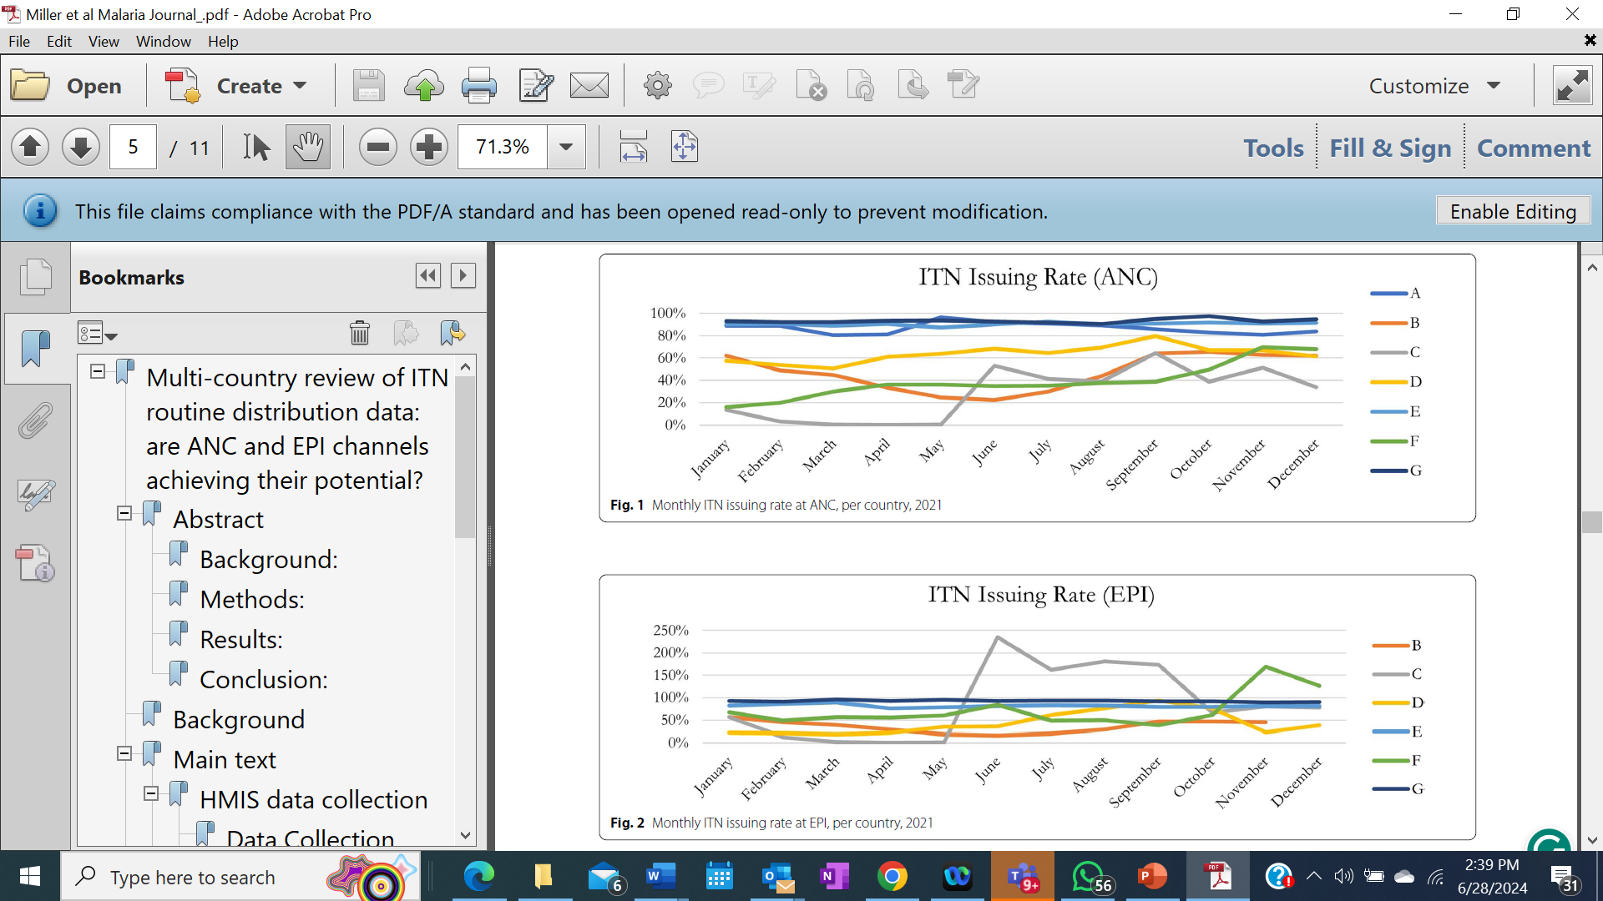
Study Findings
ITN issuing rates varied across countries at ANC (31% to 93%) and EPI (39% to 92%).
Across the seven countries, the median ITN issuing rate was 64% at ANC and 78% at EPI.
Results varied greatly across months per country at both ANC and EPI.
NMP focal points mentioned that mass campaigns often negatively affect the implementation of ITN distribution through ANC and EPI, even though global and national guidelines emphasize sustaining CD during campaigns.
Notes:
ITN issuing rate varied from 31% to 93% percent at ANC and 39% to 92% at EPI with the median issuing rate being 64% at ANC and 78% at EPI. There was variation in monthly issuing rate for both ANC and EPI as shown on the graphs. There’s usually a decline in the issuing rate during months of mass campaigns as ITNs meant for routine distribution are often used to fill mass campaign gaps according to NMP focal points.

Slide 4
Barriers to Optimal Performance
Inconsistent and sometimes inadequate ITN stock
Lack of updated guidelines on ITN distribution and utilization
Lack of recommended registers and other tools leading to improvisation
Low funding for social behavior change activities lacking at the facility level.
Notes:
Erratic supply of ITNs. Lack of updated guidelines. Improvisation of standard registers and low SBC funding are some of the barriers to routine ITN performance. I’ll hand over to Ketty to continue with the Zambia ITN issuing rate report. Thank you. Over Ketty.

Slide 5
Background –Zambia ITN Issuance Rate
In 2023, the Zambia NMEC with support from PMI Evolve conducted data analysis of the ITN issuing rate from 2021-2023
The objectives of the assessment were to:
  Review Zambia’s 2022 ANC and EPI health facility monthly data by district to see where performance was sub-optimal, compared against 2021 results,
  Review the 2023 quantifications and logistics plans to see if there were any apparent indications of barriers to optimal performance this year and, if so, devise activities to mitigate risk.
Zambia’s 2021 data on ANC and EPI ITN distribution was included in the multi-country review which revealed that the national ANC issuing rate was only 40% while the EPI rate was at 75%.
Zambia population is approximately 20 million people and out of this the number of expectant pregnant women to visit ANC centers is 1.1 million (5.4%), while the number of children (<1 years) to visit EPI centers is 1 million (5.2%).
  Approximately 2.1 million ITNs are required annually for routine distribution through ANC and EPI.

Slide 6
Methodology
The NMEC provided HMIS-DHIS2-based ANC and EPI ITN issuance data for 2022 and 2023.
  The 2021 issuing data from the multi-country assessment was also included in this Zambia-specific analysis to obtain better performance trends.
The data was analyzed using Microsoft Excel to show regional performance trends. The data was also visualized on maps to provide additional perspective of sub-national performance patterns.

Slide 7
Provincial Level Analysis
Between 2021 and 2023, 1.1 million and 1.4 million ITNs were issued at ANC and EPI centers, respectively.
Across all years, 47% of the 2.3 million pregnant women attending ANC and 68% of the 2.1 million eligible children at EPI received an ITN.
40% of pregnant women at ANC received an ITN in 2021, 50% of pregnant women received an ITN in both 2022 and 2023.
At EPI, the number of ITNs issued increased in 2022 compared to 2021 but decreased in 2023 compared to 2022.
More children received the 1st measles vaccination dose in 2022 than 2021 and less in 2023 than in 2022. This translated to 75% of eligible children receiving an ITN in 2021, 64% in 2022, and 66% in 2023.

Slide 8
ITN Issuing Rate at ANC, per Year, per Province, 2021-2023
Notes:
Some provinces (Central, Muchinga, North-Western, and Northern) improved their ITN issuing rates at ANC year after year, although most did not reach NMEC target of 100%. Eastern province was the only one to reach 80% in 2023. Copperbelt, Lusaka, and Southern provinces had ITN issuing rates at ANC less than 40% in 2023, and all three had performed better the year prior.

Slide 9
ITN Issuing Rate at EPI, per Year, per Province, 2021-2023
Notes:
At EPI, most provinces had high issuing rates, reaching more than 80% of eligible children in 2023. North-Western and Northern provinces saw improvements year after year. Copperbelt province fell from 77% in 2021 to 11% in 2023. Lusaka province improved from 30% to 73% from 2021 to 2022 but then dropped back down to 24% in 2023. Similarly, Southern province increased from 65% in 2021 to 81% in 2022 but then dropped back down to 38% in 2023.

Slide 10
District Level Analysis
Between 2021 and 2023, there was variation in ITN issuing rates at the district level with few consistent upward trends. Overall, districts in the northern and southwestern zones of the country were the highest performing.
A few provinces had districts that had issuing rates at or above 90% across all three years. These included Muchinga (Mafinga and Isoka districts), Northern (Mbala district), North-Western (Kabompo district), and Luapula (Mwense and Samfya districts).
At the district level, issuing rates at EPI were generally higher than issuing rates for ANC across all three years.

Slide 11
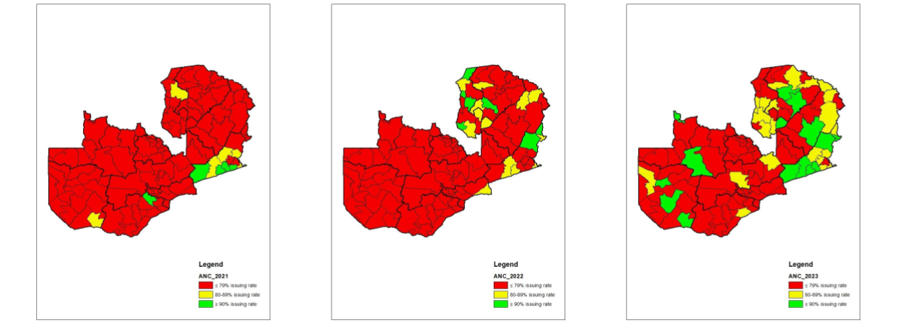
ITN Issuing Rates at ANC by District, 2021-2023
Notes:
Between 2021 and 2023, there was variation in ITN issuing rates at the district level with few consistent upward trends. In 2021, ANC issuing rate was below 80%, which improved in 2022 to 80% but less than 90% and by 2023 a good number of districts were 90 or greater than 90%

Slide 12
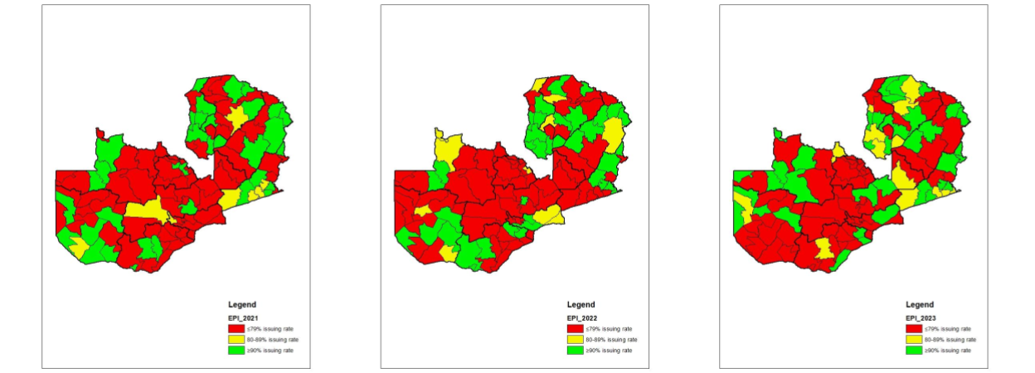
ITN Issuing Rates at EPI by District, 2021-2023

Slide 13
Key Findings (1)
Inconsistent and inadequate supply of LLINs continues to be a major barrier to ensuring optimal issuing rates
There are differences in issuing rates among and within health facilities in provinces that had received ITNs for distribution.
  Issuing rates are low at ANC even for facilities recording high issuing rates at EPI and vice versa in a few cases. The observed difference in the issuing rate given ITN availability could be non-supply related such as data entry errors and needs to be explored during supportive supervision.
Gaps in reporting and data management of ANC and EPI records at facility level which results in either under reporting or duplication of entries on the number of ITNs distributed.
  Data management has been a major problem in most health facilities, and this can be attributed to factors such as limited staff at health facilities managing more than one activity at the same time and inability of staff to enter data correctly.

Slide 14
Key Findings (2)
The absence of ANC and EPI registers at some facilities leading to the use of improvised registers that do not conform to requirements may lead to reporting gaps.
  This was observed during the 2021 assessment of health facility ITN distribution. There’s a high possibility of data loss due to non-availability of appropriate registers for reporting ITNs issued.

Slide 15
Recommendations
Supportive supervision visits to heath facilities to provide on-site coaching to ANC and EPI staff
Strengthen staff capacity to accurately quantify ITN needs and improving availability of service delivery registers for accurate documentation of ITNs distributed
Identify HF data management focal point to increase effectiveness and accountability
Implement NMEP strategy for continuous resource mobilization
Increase NMEP & stakeholder accountability

Slide 16
Conclusion
The NMEC and stakeholders need to ensure that required ITN quantities are adequate to ensure stock availability all year round and this will only be possible with adequate quantification, planning and targeted advocacy on resource mobilization.
To ensure the CD task team’s mandate is actualized, the TORs should be enforced by the Ministry of Health through the NMEC and adhered to by all stakeholders and implementing partners who are part of the CD Task team including line ministries, NGOs and cooperating partners.
All HF supervisors’ capacities should be strengthened in quantifying their monthly stock to prevent stockouts and systems should be put in place for early detection of stockouts. Additionally, the needed tools (e.g., registers, guidelines, job aids) must be provided and staff sufficiently trained and supervised to improve service delivery.

Slide 17
THANK YOU
QUESTIONS?

