Slide 1
ITN Quantification Website
CDWG General Call | October 2, 2024
Stephen Poyer & Eleanore Sternberg
Tropical Health

Slide 2
Background
Quantifying ITN needs
Mass campaigns: “population estimate / 1.8” plus up to 10% buffer if population data is >5 years old
ANC and EPI services: based on estimates of the populations reached by these services (at-risk populations typically around 4-5%, each)
NetCALC and NetCALC Lite have been used for several years with support from AMP and donors, but these tools are now retired as they overestimate ITN access from the number of nets-per-capita delivered.
They also didn’t produce a simple rule of thumb quantification of “population divided by X”, like we have for mass campaigns

Slide 3
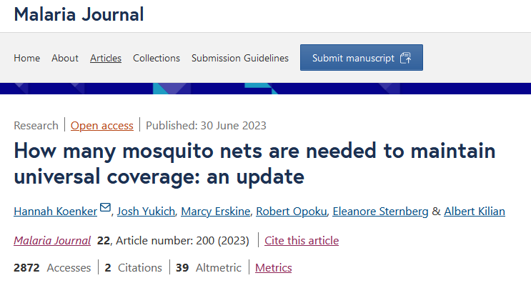
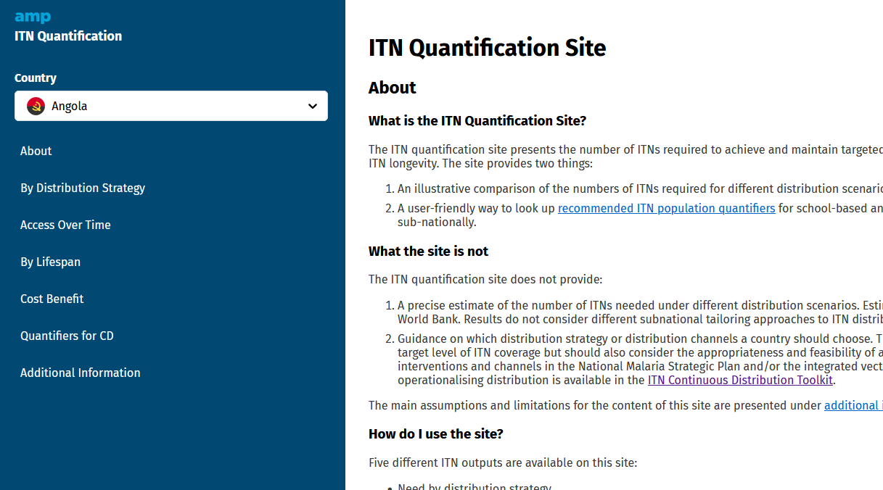
Background
Updates to ITN quantification recommendations published in 2023 for continuous distribution.
Updates use country-specific ITN retention times
ITN Quantification Site provides a user-friendly interface for key content from the publication
https://doi.org/10.1186/s12936-023-04609-z
https://allianceformalariaprevention.com/itn-quantification/index.html

Slide 4
Background
The ITN Quantification Site can be used to:
Compare ITN distribution strategies in terms of ITN access achieved and number of ITNs required
Set ITN retention time and compare the number of ITNs required for a given ITN access
Select the population-based quantification factor for continuous distribution channels, based on ITN strategy
View different outputs over 3 or 10 years for different strategies
https://allianceformalariaprevention.com/itn-quantification/index.html

Slide 5
Demo
Live orientation and demonstration of the website.
Please refer to the meeting recording to view the demonstration.

Slide 6
Feedback
We are looking for volunteers to try out the site and provide feedback
If you have any feedback, please contact us
Steve Poyer: steve@trophealth.com
Eleanore Sternberg: eleanore@trophealth.com

