Slide 1

Zambia’s Continuous LLIN Distribution Strategy
School Based Distribution
Training of Trainers (ToT)
2021
Venue : Katete District

Slide 2
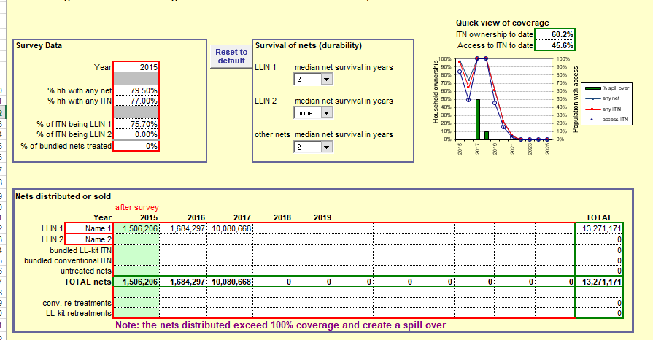
LLIN coverage drops after mass campaigns
Zambia’s coverage will drop to 60% in 2019 and 20% in 2020

Slide 3
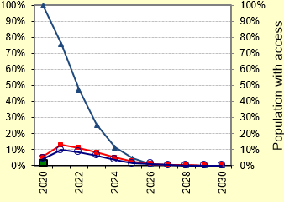
Zambia’s coverage after 2020/21 mass campaign

Slide 4

Zambia’s Continuous LLIN Distribution Strategy
INPUTS
DISTRIBUTION CHANNELS
DESIRED OUTCOME
Strong
supply
chain
Strategic
demand creation
Real-time
monitoring
Support
supervision
PUSH MECHANISMS
Antenatal care
EPI
Primary Schools
HOUSEHOLD
NET ACCESS
NET USE
Community-based NHCs
PULL MECHANISM

Slide 7
NATIONAL
PROVINCE
DISTRICT
SCHOOLS
COMMUNITY

Slide 8

Together We Can Eliminate
malaria ☺!!

