Slide 1

NATIONAL MALARIA ELIMINATION CENTRE
SBC School Based Distribution
August 20, 2021

Slide 2
Objectives
Help stakeholders to understand the Social & Behavioral Change Communications’ objectives for the school based distribution of LLINs
Help stakeholders to understand the different levels for SBCC required before, during and after the distribution of LLINs.
Share some communication channels & messages that could be used before, during & after the exercise

Slide 3
The school distribution program is one of the strategies that MOH uses to ensure that more families and community members have access to LLINs for malaria prevention.
In this program, MOH engages pupils and students as agents to receive and transport LLINs into households
The school distribution targets pupils in grades 1 and 4 only
These LLINs are given to the pupils for free.

Slide 4
Cont…
The school based LLINs distribution program is not a mass distribution.
It is a focused mode of distribution for pupils in grades 1 and 4.

Slide 5
Why is the program targeted at grades 1 & 4 only?

Slide 6
Communication strategy for the school distribution of LLINs
Communications objectives
Key communication behaviors
Proposed communication channels
Some key messages

Slide 7
Communication objectives
Increase number of children sleeping under LLINs
Increase children & family members who believe that treated nets are safe to use
Increase intention of families to ensure ALL young children sleep under a treated bednets every night of the year

Slide 8
Key Driver
Lack of consistent use of LLINs by most children

Slide 9
Behavioral objective/ key outcome
Increase the number of children who sleep under LLINs consistently.

Slide 10
A lack of self-efficacy around hanging a LLINs
A perception that treated LLINs are not safe
Use of bednets by heads of households instead of most vulnerable members

Slide 11
SBCC objectives for the school based distribution of LLINs
Understand that Teachers and pupils are important agents of change in our communities.
It is the therefore important to inspire them to talk to parents, friends and other community members about the distribution, use and care of LLINs.
Promote and Sustain net use and care

Slide 12
Some proposed channels of communication
BEFORE distribution?
Create awareness about the school distribution process
Proposed channels:
School assemblies
Use of malaria clubs in schools if available
School quiz competitions
Village Meetings
Talking walls?

Slide 13
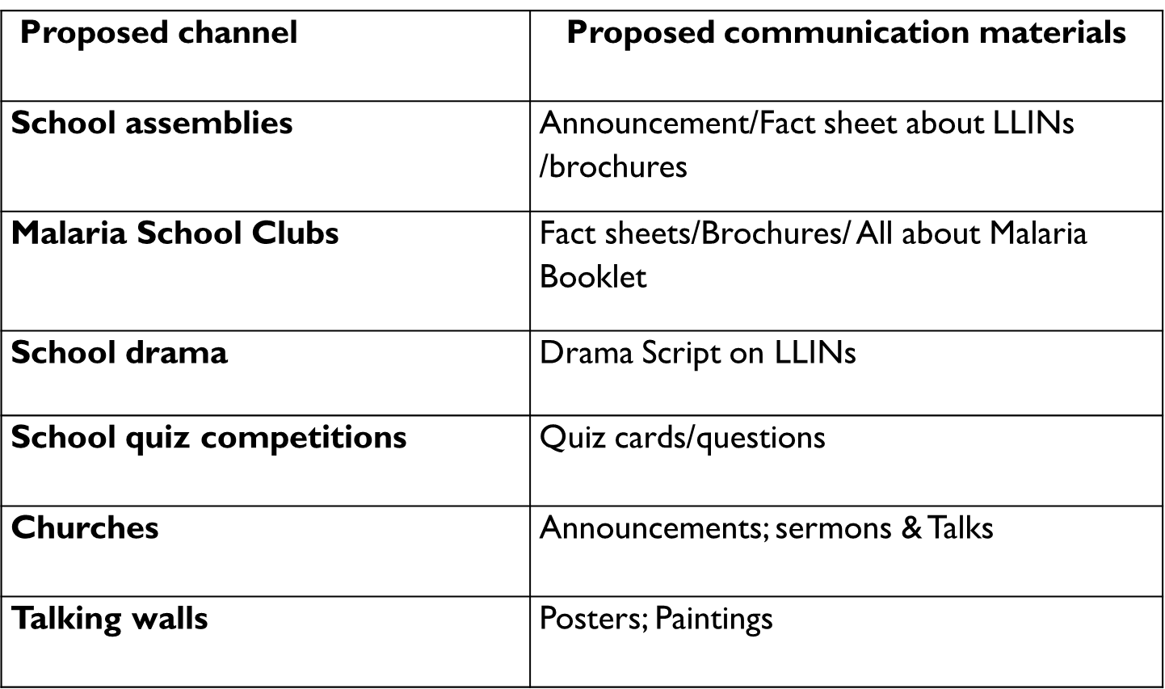
Summary Communication Plan

Slide 14
Some key announcements & activities for School Based Distribution
Pre Distribution:
When LLINs will be distributed…..
Where LLINs will be distributed…..
To who LLINs will be distributed…..

Slide 15
DURING distribution
Children to be instructed/told to take the LLINs home after receiving.
Remind children to tell guardians to hang the LLIN for children
Demonstrate correct hanging, use & care for LLINs

Slide 16
Post Distribution
Continue discussing importance & benefits of using LLINs every night
Monitor to see how many ITNs were taken to homes and how many are being used and whether the children are now sleeping under ITNs

Slide 17
SBCC Roles & responsibilities
Notes:
Discussion: Before we go on to roles and responsibilities, are there any questions about the planned messages and activities?

Slide 18
Provincial level tasks
Participate in possible pre-testing of SBCC materials should there be any development of such
Briefings for key stakeholders at the province level, including ministry of education staff
Monitor timely and quality of orientations, registration visits, LLINs’ demonstrations during distribution
Follow up to correct possible rumors/misconceptions arising from the distribution

Slide 19
District level tasks
Work with designate focal person(s) (HPFP) for SBCC support to the school distribution
Briefing for schools (present at school assemblies)
Review and pre test scripts for school dramas
Ensure announcements in churches are done
Monitor and correct rumors/misconceptions

Slide 20
Health center level
Orientation of community volunteers on SBCC materials and registration processes
Distribution of SBCC materials to school teachers and pupils
Ensure all eligible pupils receive ITNs and confirm that they are taken to their homes
Announcement in churches by health center staff
Household visits to confirm receipt of LLINs & correct rumors/ misconceptions

Slide 21
Community & School levels
  Announcement during school assemblies
  Zonal head to take advantage of possible community meetings by traditional leaders to share about school distribution program
  Household visits by teachers in collaboration with community health volunteers

Slide 22
Pupils in grades 1 and 4
Tell their parents about the school distribution program
Attend school on the day of distribution
Take the net home on the same day that they receive it
Encourage family members, friends and neighbor to sleep under a net every night

Slide 23
