Slide 1

Determinants of ITN durability in sub-Saharan Africa
Secondary analysis from 37 durability monitoring sites
Stephen Poyer, Matt Worges and
Eleanore Sternberg
Tropical Health
October 2025

Slide 2
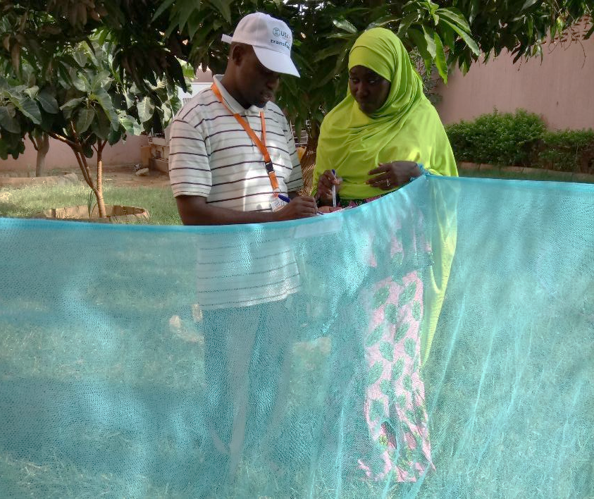
Background
The physical durability of insecticide-treated nets (ITNs) is an important component of the effectiveness of ITNs for malaria prevention.
Evidence shows that ITNs have variable durability
  The median retention time does not necessarily span the typical three-year period between mass campaign distributions to households.
ITN physical durability can be affected by the household environment in which nets are used, daily net handling practices and individual attitudes to nets.
Identifying the most important household and behavioural determinants of ITN survival can help improve net handling, use and care through targeted social and behaviour change (SBC) interventions.

Slide 3
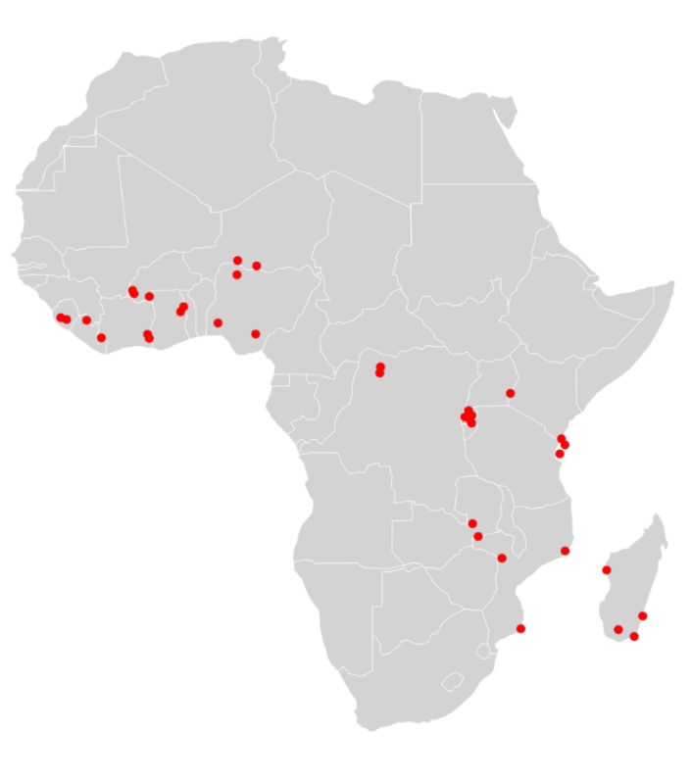
Methods
This secondary analysis used data from 37 durability monitoring sites in 15 countries covering 13 ITN brands distributed in mass campaigns between 2015 and 2021.
All studies followed the standard PMI durability monitoring protocol, tracking ITNs up to four times over three years after distribution.
ITNs underwent a physical hole count at each timepoint, and data were captured on household, behavioural and net factors.
  Household: Household size, wealth, whether cooking or food storage occurred in sleeping areas.
  Behavioural: Attitudes toward ITN care and repair, exposure to SBC messages
  Net: Handling practices, net users, net washing and drying practices,
Cox proportional hazards modelling was used to identify predictors of physical survival.
  The model used 17,466 observations of 9,237 ITNs over 14,218 ITN-years at risk.
Approximate locations of the 37 durability monitoring sites included in the analysis

Slide 4
Variation in ITN physical survival
Across study sites ITN median survival ranged from 1.6 to 6.0 years, with an overall median value of 2.7 years.
Sites in Côte d’Ivoire, Liberia and Nigeria had some of the highest survival times, exceeding 4.5 years.
Sites in Burundi and DRC had the lowest survival times, with median survival below two years.
ITN median survival in years for ITNs in 37 study sites
Assumed 3-year survival
Data show median ITN survival time in years for 37 study sites, ranked by value. Study sites are identified by the ISO-3 country code and a site number.
The orange horizontal line indicates a median survival of 3 years.

Slide 5
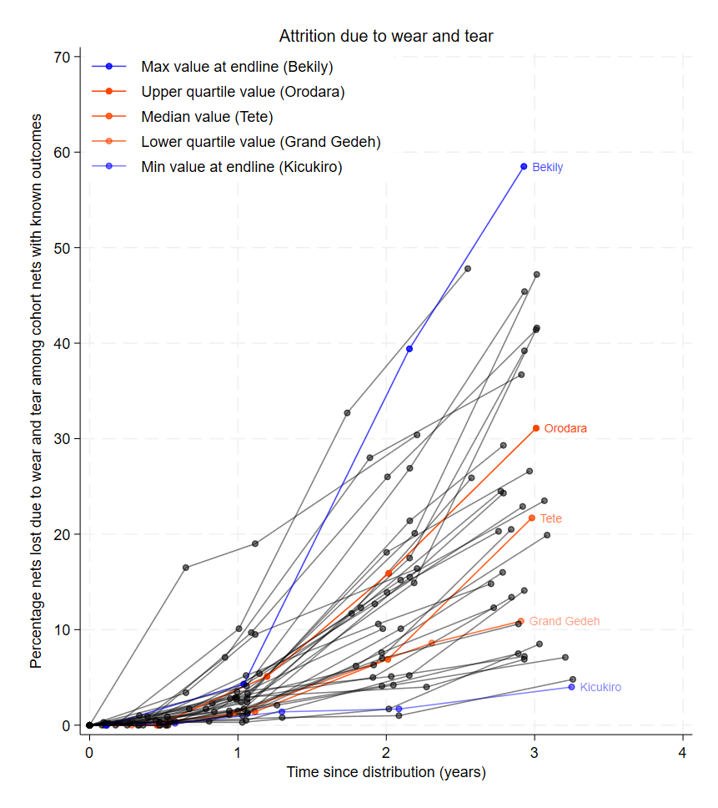
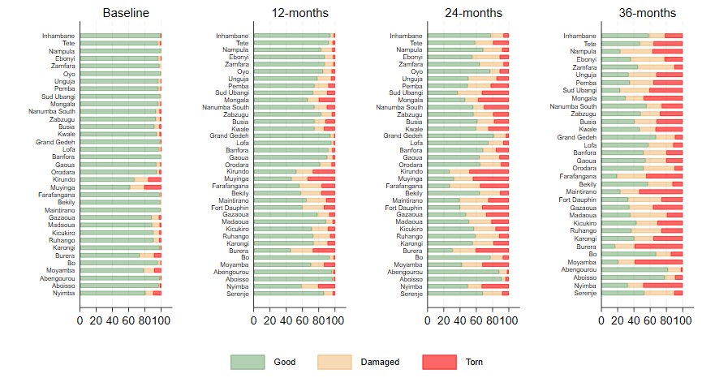
Components of ITN physical survival
ITN survival is determined by the combination of net attrition and physical damage to nets present in households.
Attrition due to wear and tear: ITN attrition ranged from 4% to 59%, with a median of 20% across sites.
Physical integrity: Among nets still in households, the proportion classified as “torn” after three years ranged from 2% to 59%, with a median of 30%.
Attrition due to wear and tear since distribution by study site
Physical integrity of remaining ITNs by study site, over time
Line colour indicates sites with max and min values (blue) and quartile values (orange)

Slide 6
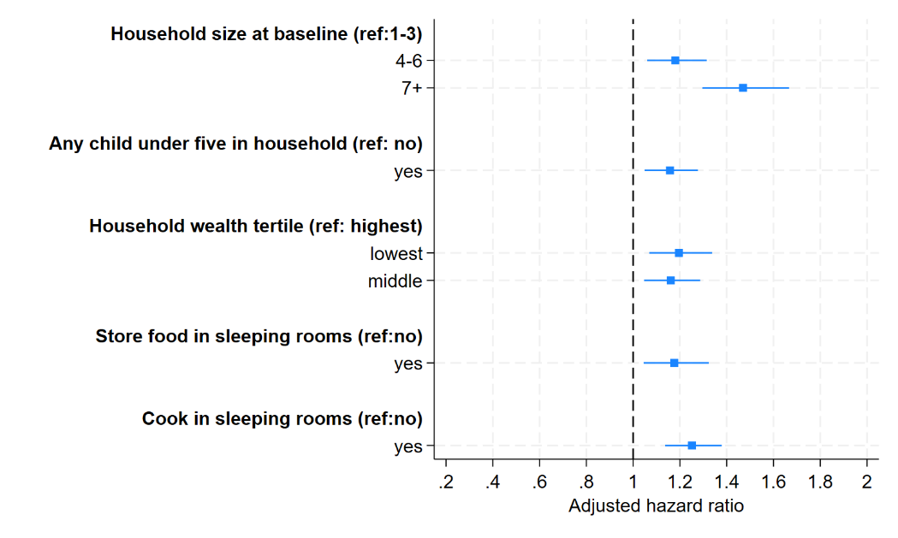
Determinants of ITN survival: Household level
Ten variables were independently associated with ITN survival, including five at the household level.
Adjusted hazard ratios and 95% confidence intervals for significant household-level determinants of ITN survival
ITNs in larger households (4—6 and 7+ people) were at increased risk of failure compared to ITNs in 1—3 person households.
Other household-level risk factors for ITNs were:
Households with one or more children under five
Households in the middle and lowest wealth tertiles (compared to the highest tertile)
Households that report storing food in rooms used for sleeping
Households that report cooking in rooms used for sleeping
Increasing risk of failure
(i.e. ITN less likely to survive)

Slide 7
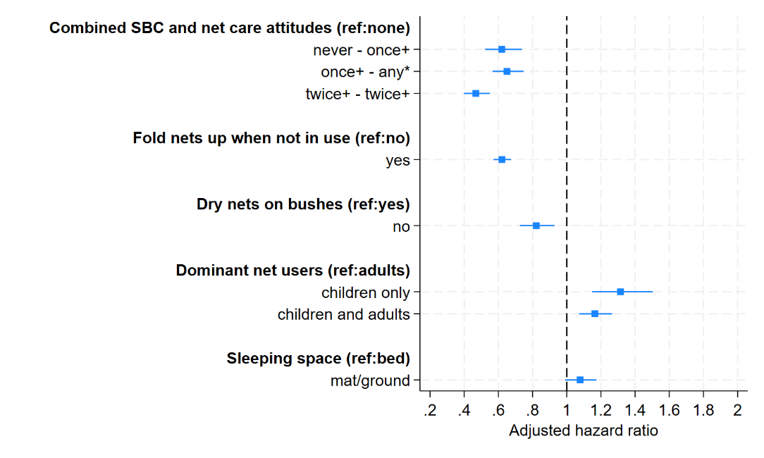
Determinants of ITN survival: Behavioural and net levels
Five behavioural- and ITN-level factors were also associated with ITN survival.
Adjusted hazard ratios and 95% confidence intervals for significant behavioural and ITN-level determinants of ITN survival
ITNs had half the risk of failure (53%) in households where respondents reported high levels of SBC exposure and positive care attitudes
ITNs always folded up when not in use had 38% decreased risk of failure.
ITNs that were never dried on bushes had 18% lower risk of failure.
ITNs that were used by children sleeping on their own or with adults were at greater risk of failure than nets used only by adults.
Decreasing risk of failure
(i.e. ITN more likely to survive)
Increasing risk of failure
(i.e. ITN less likely to survive)

Slide 8
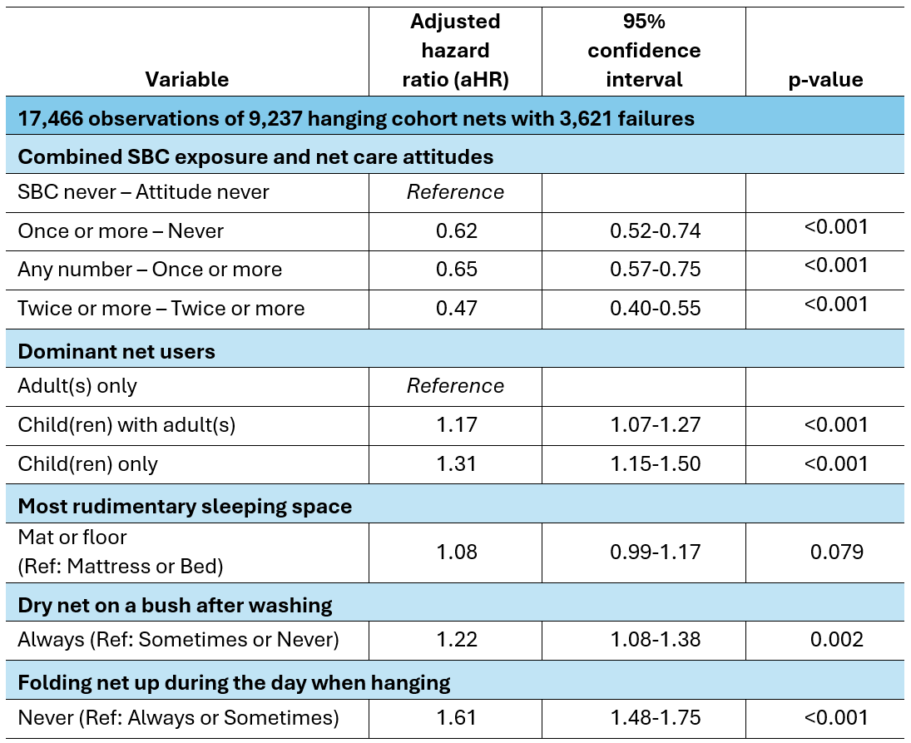
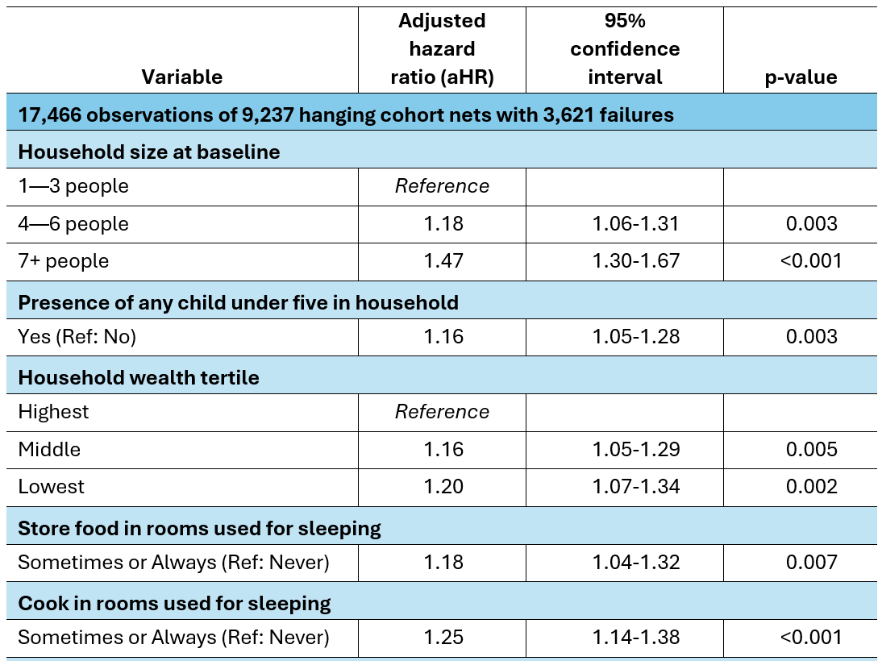
Determinants of ITN survival: Model outputs (reference)
Household-level determinants
Behavioural and ITN-level determinants

Slide 9
Summary
Median ITN survival of 2.7 years across the 37 study sites is close to the assumed three years commonly used for planning, but masks large variations across countries and settings.
Ten variables were identified as being independently associated with ITN survival.
  Repeated SBC exposure combined with consistent positive net care attitudes was highly protective, adding nine to ten months’ ITN life compared to ITNs in households with limited exposure and poorer net care attitudes.
  Folding ITNs up when not in use was also highly protective, being equivalent to seven to eight months of additional life compared to nets left hanging during the day.
  Both cooking and storing food in sleeping areas, drying ITNs on bushes after washing, and sleeping directly on the floor or on rudimentary mats were all independently associated with reduced net lifespan.
  ITNs in larger households, less well-off households and in households with young children were also at greater risk of failure.
While some of these factors are outside the direct control of households, these findings suggest that interventions targeting improved household practices and net care attitudes have the potential to meaningfully extend ITN serviceable life.

Slide 10
Implications for programming
SBC interventions should prioritize households at greater risk of ITN damage, including large and poorer households and those with children under five.
Messaging should reinforce folding nets when not in use, gentle handling, and drying on washing lines rather than on bushes.
ITN strategy development efforts can use durability monitoring results to refine assumptions about ITN replacement intervals and coverage planning as part of a comprehensive ITN channel assessment.
Improving physical ITN survival will enhance the impact and cost-effectiveness of national malaria control efforts by preventing malaria transmission for longer with existing commodities and reducing the number of new cases.

